Slide 1
GreenQQ UI

Slide 2
Procedure Overview
Setup:
Page Cleaning
Document Error Correction (OCR, typesetting, and author errors)
Initialization of template document and typical page to begin template development
Template Development for Book/Record Type:
Individual
Family
Multi-generational Family
Active Learning – i.e., system points to needed additional work:
COMET User Corrections
Additional:
Template Development
Document Error Correction
Page Cleaning
Notes:
Active learning should occur throughout – during template development as well as post template development.
Active learning must no go overboard (become paper-clip-like).
Active learning should support user exploration in understanding why something is not working out as expected – likely especially so during initial template development.
Does a page or part of a page need further cleaning? Does an uncaught OCR error prevent a template from working? (Perhaps just allowing a user to view the underlying text document would help.)
Why does my template fail? (Perhaps seeing the Check File would be of use – with the ability to easily relate it to the template that labeled a token (click on T#?))
Hand adjustment of left and right context should be available – perhaps on the text file with the Extract and left- and right-context highlighted; and then with the context highlights adjustable.

Slide 3
GreenQQ Template Development Strategy
Create templates for a typical page or two.
Create templates for missing record heads (as guided by suggestions)
Record heads are persons (those whose eternal welfare is at stake)
Suggestions point to needed additional work (the principle of active learning)
Address other issues (as guided by suggestions)
First address issues requiring:
Further template development
OCR/Typesetting corrections
Page cleaning
Finally make COMET editing corrections
Notes:
Ideally, a trained service missionary should be able to do all of this: page cleaning, OCR/typesetting corrections, template development, and COMET corrections. (We don’t expect this UI will be for general patron use, whereas Ui’s for importing information into the FamilySearch Tree, into LLS, and into CDS are expected to be for general patron use.)
The typical page should be chosen by the setup service missionary; the user should be able to browse to see how well the initial-page templates work throughout and possibly choose to work on a second page (a third, … ?).
… it looks like I should code a statistical check for outlier pages for all household person names and possibly on birth and death info too

Slide 4
GreenQQ UI: Theory & Practice
Theory
Determine record types by data-base normalization theory (both flat and nested)
Each record type has a record head – the non-lexical Person object to whom the rest of the information in the record pertains.
Ontological commitment with Name provides the textual value associated with a Person object identifier.
Semi-structured expectation
Multi-token values of interest (like names) must be textually contiguous (not Butler-like where a surname appears at the top of a list of given names)
For a record R, the information space pertaining to R appears is the text between successive R record heads.
In practice, a limited number of exceptions are acceptable.
Practice
Record types and exceptions to semi-structured expectations determine classifications of records in a book type.
All records in a book have the same classification. (Page ranges that have the same classification are acceptable.)
The UI layout should be presented in the simplest form wrt the book’s classification
Exceptions
EXTRA information may appear in a record’s textual space and may need a STOPper to prevent forming unwanted relationships.
Nested records for Individuals may appear in a record’s textual space (Flögeln SPOUSE, PARENT1, PARENT2, CHILD).
Many-one relationships can allow head persons to share information in a record’s textual space (Kilbarchan twins).
Information for a particular record type may be intertwined among household spouses and children (Flögeln marriages).
In my mockups I’ve used color to highlight different template patterns, but I’m thinking that in the implementation, the colors should go with categories (e.g., all BirthDates the same color etc.)
Notes:
Semi-structured properties must be syntactically discernable.
Ely and Harwood are examples of books where we would want to select page ranges. (Ely is mostly semi-structured but beginning only after the first few generations; Harwood is mostly unstructured but has semi-structured pages toward the end.)

Slide 5
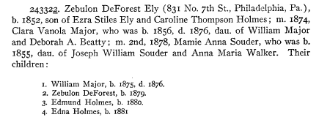
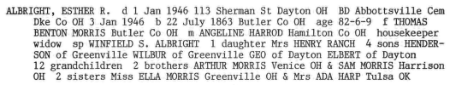
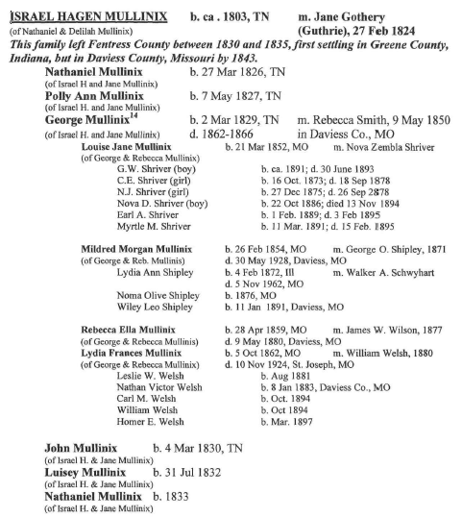
Book/Record Types Entail UI Layouts
Family
Family- (Kilbarchan)
Family (Ely)
Family+BySpouse+Individual+ReferenceID (Flögeln)
Individual
Individual (Hampshire)
Individual+EXTRA (Miller)
Individual+FactoredSurname (Butler)
Multi-generational Family:
Multi-generationalFamily (Mullinix)
(Likely +Variations)
Notes:
Basic principles for the UI: (1) fundamentally it’s an entity recognizer for lexical objects, (2) it’s sectioned into records for units of work with the layout being dictated by the book type, (3) record heads are non-lexical persons represented by names (via ontological commitment)
The three UI Layout Types have a different record structure layout with variations for the sub-UI types. (Theoretically, according to our ontology, there should be no more Book Types: Individual for non-lexical Person view, Family for the view consisting of non-lexical Person and its specializations Spouse and Child, and the view of the non-lexical object sets that includes recursion over multiple generations through the Person-Child relationship set.)

Slide 6
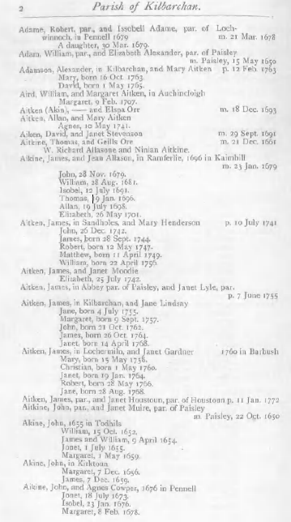
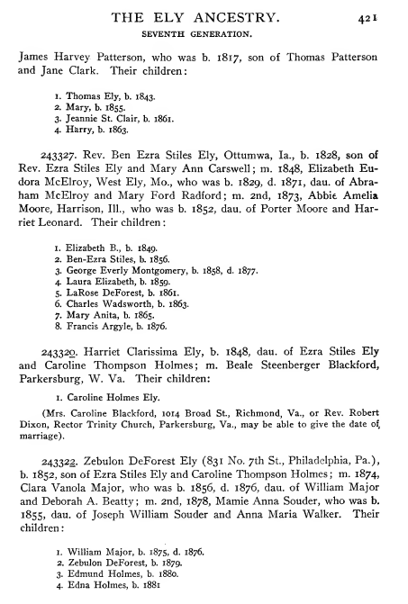
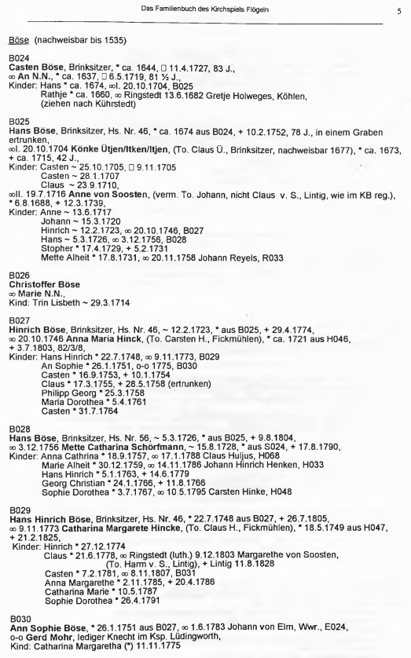
Family Record Types
(Groups, Households, Vitals, Marriages, Parents)
(Flögeln)
Family- (Kilbarchan)
Family (Ely)
Family+BySpouse+Individual+ReferenceID
Notes:
Variations:
Family-: There are no Parent records in Kilbarchan. (In general, Family- denotes that any one or more of the record types Vitals, Marriages, and Parents may be omitted.)
Family: header with parents (including all spouses of the head of household) followed by children; parents may have parents in their record space and children may have spouses in their record space.
Family+BySpouse+Individual+ReferenceID: (In general, Family+ may have any one or more of these added properties.)
BySpouse: when the head-of-household has multiple spouses, the children are participation by spouse.
Individual: one or more one-hop-related persons may appear in a person’s record space (e.g., former spouses in a household parent’s record space); moreover, these one-hop-related individual may have associated vital, marriage, or parent information.
ReferenceID: each household has a unique ID, and references to these household IDs can appear in place of a person name in a person’s record space. (In general, a reference could be to any person or persons or any date or place within the household, but for now we only programmatically resolve them to one person name or not at all.)

Slide 7
Automatic Template Creation
Groups (Group IDs and HeadNames)
Group IDs
Left to SOL and if always preceded by a blank line, SOL EOL SOL
Right to the end of the Group ID and on to EOL, if on a line by itself
HeadNames: With Group IDs
Left through the Group ID’s left context
Right to end of HeadName
HeadNames: Without Group IDs
Left to SOL and if always preceded by a blank line, SOL EOL SOL
Right to end of HeadName and on to EOL, if on a line by itself
Content
With LIT identifier
Left to the LIT identifier – and, for household person names, continuing through any white space to SOL
Right to the end of the data value
Without LIT identifier
Left to next non-punctuation token (the user may wish to declare the token to be a LIT) – and, for household person names, continuing through white space to SOL
Right to the end of the data value
Notes:
LITs like “aus” in Flögeln and “born” and “and” in Kilbarchan are useful.

Slide 8
User Adjustments to Auto-created Templates
SOL TAB Rathje * ca . 1660 , oo Ringstedt 13 . 6 . 1682 Gretje Holweges , Köhlen , EOL
SOL TAB Rathje * ca . 1660 , oo 13 . 6 . 1682 Gretje Holweges , Köhlen , EOL
SOL TAB Rathje * ca . 1660 , oo Gretje Holweges , Köhlen , EOL
The default pattern for MarriageEventPlace is “oo CAP” which matches both “oo Ringstedt” (in the first example above) and “oo Gretje” (in the third).
SOL TAB Rathje * ca . 1660 , | oo Ringstedt | 13 . 6 . 1682 Gretje Holweges , Köhlen , EOL
SOL TAB Rathje * ca . 1660 , | oo Ringstedt 13 | . 6 . 1682 Gretje Holweges , Köhlen , EOL
SOL TAB CAP * yy . NUM4 , | oo CAP | NUM1or2 . NUM1or2 . NUM4 CAP CAP , CAP , EOL
SOL TAB CAP * yy . NUM4 , | oo CAP NUM1or2 | . NUM1or2 . NUM4 CAP CAP , CAP , EOL
Notes:
Users must have access to and the ability to adjust any template. (The rule: “Right to the end of the data value” is particularly problematic; “one beyond” is not good in general because of too many variations).
The adjustments can only be made by extending/shortening left and right context. (The adjustment may run across line boundaries.)
We can do the adjustment either on an example itself or on the tagged tokens. (The user should probably see both.)
For LITs in the above, I’ve assumed “oo” is a LIT and “ca” is not. The setup person should specify all symbols that designate person roles or that designate date- and place-types as LITs.

Slide 9
GreenQQ UI (Family-)
Adame, Robert
STOP
Head Name
Groups
Adame, Robert
Spouse Name
Child
Household Members
Adame, Robert
Birth Date
Birth Place
Christening Date
Christening Place
Death Date
Death Place
Burial Date
Burial Place
Vitals
Adame, Robert
Spouse Name
Marriage Event Date
Marriage Event Place
Marriage Information
Notes:
Assumed HeadName format variations: <lastName>, <givenName>{1,2}
A reasonably careful look should reveal three missing HeadNames:
“Aitken (Akin), -----”: Will service-mission patrons know what to do in this case? (Probably, even though there is no given name and a parenthetical alternate surname, and a special template can be created.)
“W. Richard Allasone”: a little tricky to see because it is indented, and the text must be read to see that it is not just a wrap-around line. (A special template can be created.)
“Aitken, James”: puzzling, for it looks right. Here it would be useful to be able to see the text behind the page – COMET already has this facility (see next slide); the Check file may also help.

Slide 10
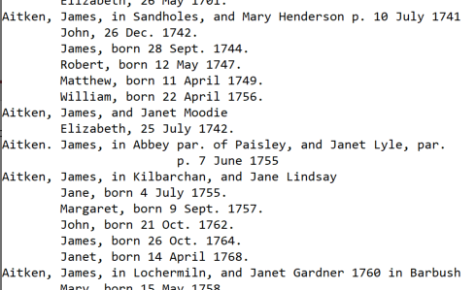
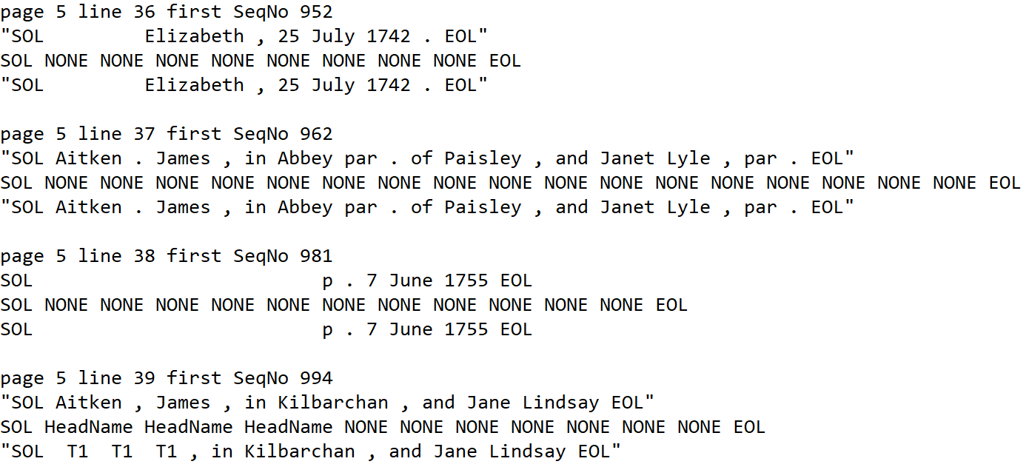
GreenQQ UI (Family-)
KilbarchanParish.005.txt
GroupHeadCheck.GroupHeadInfo.txt
Notes:
The .txt file could be shown in the COMET text view, which would also have the highlights.
The Check file could be displayed when a patron right-clicks on some line in the COMET view.
Aside: The T#’s in the Check file refer to the template numbers of the of the templates that labeled tokens. (It’s sometimes useful to see the template.)

Slide 11
GreenQQ UI (Family-)
Adame, Robert
STOP
Aitken (Akin)
Aitken. James
W. Richard Allasone
Head Name
Groups
Adame, Robert
Spouse Name
Child
Aitken (Akin)
Aitken. James
W. Richard Allasone
Household Members
Adame, Robert
Aitken (Akin)
Aitken. James
W. Richard Allasone
Birth Date
Birth Place
Christening Date
Christening Place
Death Date
Death Place
Burial Date
Burial Place
Vitals
Adame, Robert
Spouse Name
Marriage Event Date
Marriage Event Place
Aitken (Akin)
Aitken. James
W. Richard Allasone
Marriage Information
Notes:
The Family UI is for Kilbarchan-like books whose personas are household members and only household members – no parents of household parents, no spouses other than household spouses, and no children of children.
After a click on “Adame, Robert”; note that three heads have been missed, one of them subtle because it’s indented. (BTW, we may need to globally determine the left TAB settings, if we don’t already because children must always be indented by two TABS even when a particular page has no examples of single-TAB indentation.) Three more clicks are needed to get all the Head Names for this page. (UI question: should red lines be in or out?)
For FloegelnOFB, we were able to set a STOPper on the ID; here we can’t because the STOPper would need to be the household head (and we can’t double label any token). (It will be easy to miss a household head and hard to programmatically help the user find the ones we miss – this might be an argument in favor of keeping red lines to make it visually easier to see missed heads.)

Slide 12
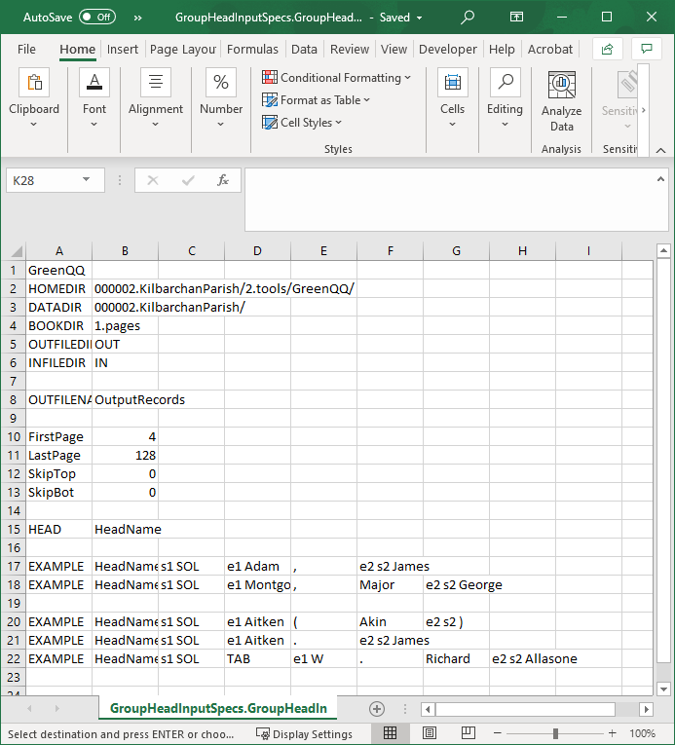
GreenQQ UI (Family-)
GroupHead
Notes:
Given head-name format variants (last name first + comma + one or two given names), the first two templates come from a click on “Adam, James”. (“Major” may be a title, but that’s OK.),
The third template is needed because of an author variation of a HeadName, the fourth is needed because of an OCR error (comma OCR’d as period), and the fifth is needed because of an author variation and a non-standard name form. All require a click.
4 clicks for 5 templates

Slide 13
GreenQQ UI (Family-)
Adame, Robert
STOP
Aitken (Akin)
Aitken. James
W. Richard Allasone
Head Name
Adame, Robert
Issobell Adame
Mary
Household
Aitken (Akin)
Spouse Name
William
Aitken. James
Child
W. Richard Allasone
Adame, Robert
Aitken (Akin)
Vitals
Aitken. James
W. Richard Allasone
Issobell Adame
Mary
William
Birth Date
Birth Place
Christening Date
Christening Place
Death Date
Death Place
Burial Date
Burial Place
Adame, Robert
Issobell Adame
Marriage Event Date
Marriage Event Place
Marriages
Aitken (Akin)
Aitken. James
W. Richard Allasone
Notes:
Note: For the SpouseNames, Children, (and dates and places later), only the ones clicked are highlighted – all are to be highlighted on hover.
SpouseName templates and Child templates propagate down to Vitals, but not to Marriage Information. (The GreenQQ Family UI is only for household head marriages.)
MarriageEvent information is added later.
STOP available, but in Kilbarchan there is nothing to mark the beginning of a household. (The names of the household heads, which cannot also be labeled as a STOPpers, are the only indicators of the beginning of a household.)
… I should check the template for Child – by default it should be SOL TAB TAB <Kalbarchan Given Name>; but I suspect that there are pages where there is only a single TAB … how do we alert patrons to this?

Slide 14
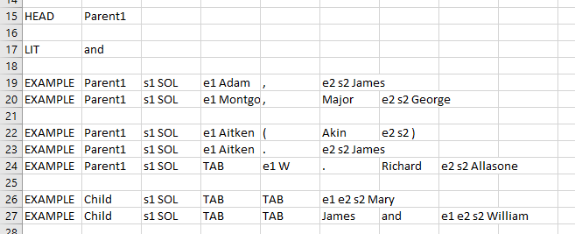
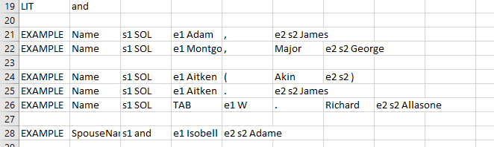
GreenQQ UI (Family-)
Family
Marriage (partial)
Notes:
The format variant for Child names is just a single given name; the format variant for household spouses is given name + maiden surname.
Two Child templates are needed, the second for twins (two clicks); a single click is all that’s needed for all spouses on Kilb005. For both twins and spouses, “and” needs to be a LIT; the left context for spouses can be just “and” so long as the left context for the second twin extends back to SOL. (How do we determine this automatically? The mistake of not extending the context for twins (and thus having the second twin labeled as SpouseName) may be hard for the user to see, and without some overly specialized processing, hard to catch programmatically.)
Only head spouses are added to Marriage at this point (one pattern, one click).
3 clicks for 3 templates

Slide 15
GreenQQ UI (Family-)
Adame, Robert
STOP
Aitken (Akin)
Aitken. James
W. Richard Allasone
Head Name
Adame, Robert
Issobell Adame
Mary
Household
Aitken (Akin)
Spouse Name
William
Aitken. James
Child
W. Richard Allasone
Adame, Robert
Aitken (Akin)
Vitals
Aitken. James
W. Richard Allasone
Issobell Adame
Mary
William
16 Oct.1763
Birth Place
9 Feb. 1707
Christening Place
Birth Date
9 April 1654
Christening Date
Death Date
Death Place
Burial Date
Burial Place
Adame, Robert
Issobell Adame
Marriage Event Date
Marriage Event Place
Marriages
Aitken (Akin)
Aitken. James
W. Richard Allasone
Notes:
Simple left context, “born”, works for BirthDates, but not for ChristeningDates, for which we should go all the way back to SOL. (Going back to just the comma or just name+comma is ambiguous with marriage places followed by marriage dates, e.g., “Paisley, 15 May 1650”.)
Format variants for dates are for abbreviated/non-abbreviated month names. Thus, only one click is needed for BirthDate; for ChristeningDate, the twin-left-context-pattern requires a second click.

Slide 16
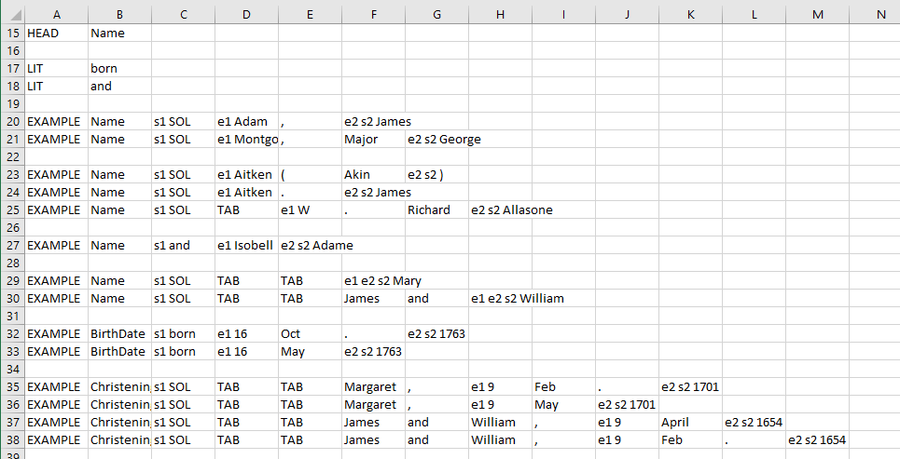
GreenQQ UI (Family-)
Person
Notes:
With the date format variant, 3 clicks produces 6 templates.

Slide 17
GreenQQ UI (Family-)
Adame, Robert
STOP
Aitken (Akin)
Aitken. James
W. Richard Allasone
Head Name
Adame, Robert
Issobell Adame
Mary
Household
Aitken (Akin)
Spouse Name
William
Aitken. James
Child
W. Richard Allasone
Adame, Robert
Aitken (Akin)
Vitals
Aitken. James
W. Richard Allasone
Issobell Adame
Mary
William
16 Oct.1763
Birth Place
9 Feb. 1707
Christening Place
Birth Date
9 April 1654
Christening Date
Death Date
Death Place
Burial Date
Burial Place
Adame, Robert
Issobell Adame
21 Mar. 1678
Paisley
Marriages
Aitken (Akin)
15 May 1650
Marriage Event Place
Aitken. James
Marriage Event Date
W. Richard Allasone
Notes:
With two marriage symbols, p & m, and two date format variants, we get 4 templates for each click on a date and place.
PDFindexer and OCR errors made the first marriage date on the page unusable:
Adame, Robert, par., and Issobell Adame, par. of Loch-
m 2I
winnoch, in Pennell 1679 - Mar. '678
A daughter, 30 Mar. 1679.
Assuming these errors have been fixed, clicking on this date is sufficient for obtaining all the marriage-event dates where there is no marriage place. A click on the date of either of the dates with places gets the other two.
A single click on one of the Paisleys gets both the MarriageEventPlaces. As usual for places, we add right context automatically.

Slide 18
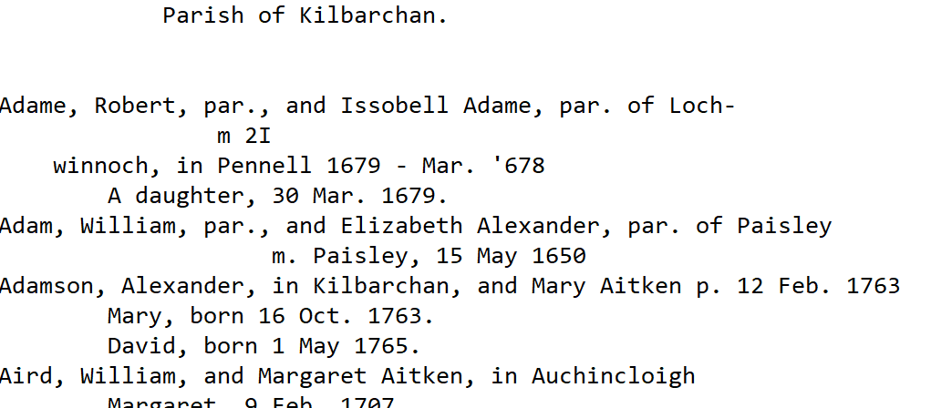
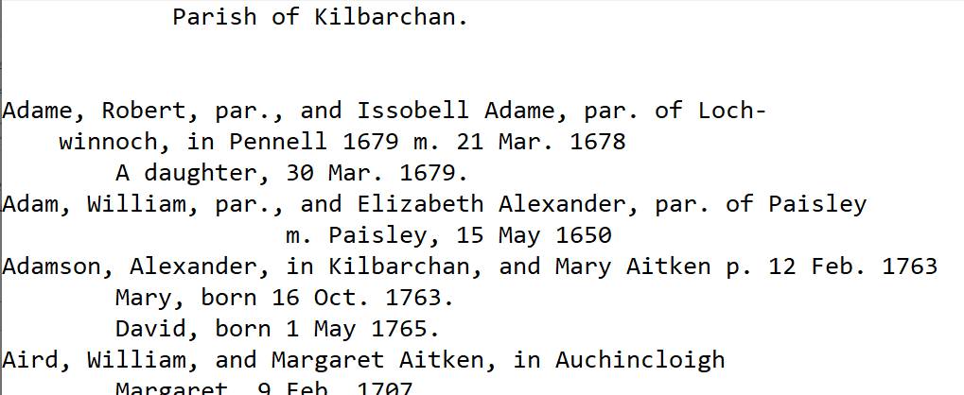
GreenQQ UI (Family-)
Notes:
… page cleaning correction by striating the line; rerun of PDFindexer to get the lines right; OCR error correction to replace the I by 1, the ‘ by 1 and discard the -, and the addition of a period after the m.

Slide 19
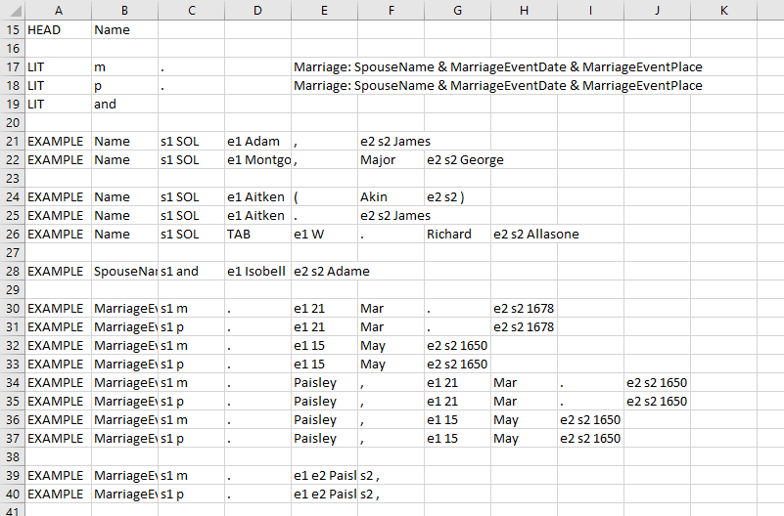
GreenQQ UI (Family-)
Marriage (now with event dates and places)
Notes:
The “m.” and “p.” are LITs and marked so that we can automatically generate templates by using them in left context.
3 clicks for 10 templates
Altogether, 13 clicks to obtain a total of 38 generated templates for 4 record types (GroupHead, Family, Marriage, and Person) – several are duplicates (but no need to enter them separately)

Slide 20
GreenQQ UI (Family)
Harriet Clarissima El
243327
Rev. Ben Ezra Stiles
STOP
Head Name
Harriet Clarissima El
Spouse Name
Child
Rev. Ben Ezra Stiles
Household Members
Harriet Clarissima El
Rev. Ben Ezra Stiles
Birth Date
Birth Place
Christening Date
Christening Place
Death Date
Death Place
Burial Date
Burial Place
Vitals
Harriet Clarissima El
Spouse Name
Marriage Event Date
Marriage Event Place
Rev. Ben Ezra Stiles
Other Spouses
Harriet Clarissima El
Parent 1
Parent 2
Rev. Ben Ezra Stiles
Other Parents
Notes:
Ely pages in the first few generations describe families in a semi-narrative form. We’ve chosen to begin with pdf page 432 which is in the middle of the sixth generation (432-700).
TAB indentation is likely error-prone because lhs pages are seemingly scanned differently from rhs pages and because of narration and picture pages are common. (I’ve chosen no to add initial TABs.)
Format variants for HeadName do not include titles (there happens to be only one “Rev.” in the pages we’re processing); two clicks required.
Since generation encodings appear at the beginning of every household, they can be used as STOPpers for runaway spouse and children lists. (Unlike Household IDs in Flögeln, this is not automatic for Family; note that HeadNames cannot also be STOPpers since no sequence of text tokens can have more than one label.)
… we could have chosen to have a ReferenceID, but since it is never referenced, we don’t.

Slide 21
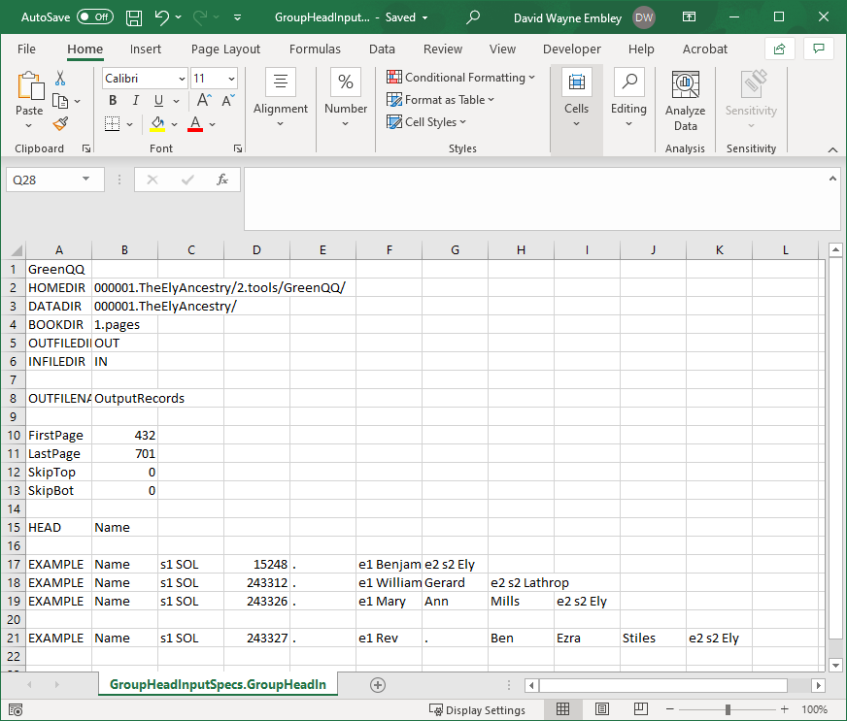
GreenQQ UI (Family)
GroupHead
Notes:
Format variants for head names are full names of two, three, and four components.
2 clicks for 4 templates

Slide 22
GreenQQ UI (Family)
…
Harriet Clarissima El
Clara Vanola Major
Thomas Ely
Household
Rev. Ben Ezra Stiles
Mamie Anna Souder
Jeannie St. Clair
Beale Steenberger B
Ben-Ezra Stiles
Spouse Name
Child
Harriet Clarissima El
Rev. Ben Ezra Stiles
Clara Vanola Major
Mamie Anna Souder
Vitals
Beale Steenberger B
Thomas Ely
Jeaninie St. Clair
Ben-Ezra Stiles
Birth Date
Birth Place
Christening Date
Christening Place
Death Date
Death Place
Burial Date
Burial Place
Harriet Clarissima El
Clara Vanola Major
Marriage Event Date
Marriage Event Place
Spouses
Rev. Ben Ezra Stiles
Mamie Anna Souder
Thomas Ely
Beale Steenberger B
Jeannie St. Clair
Spouse Name
Ben-Ezra Stiles
Harriet Clarissima El
Parent 1
Parent 2
Rev. Ben Ezra Stiles
Parents
Clara Vanola Major
Mamie Anna Souder
Beale Steenberger B
Notes:
User added STOPper (helps to prevent run-away children in households). Note: no period (Zebulon DeForest Ely’s children ran into the next family when a period was added because of an OCR error “-” for “.”).
Format variants for Child: 1-3 given names, given name + middle initial; thus, only a click on “Thomas Ely” is needed to get all but “Jeannie St. Clair” and “Ben-Ezra Stiles” (3 clicks for 17 Child names).
Household spouses are particularly interesting in this page:
Format variants for SpouseName: full names with two or three components. All household spouses on this page are covered by this format variant including those that are hyphenated. (GreenQQ is supposed to properly handle eol-hyphens – v1 doesn’t, but I believe v2 does, but in any case, it’s GreenQQ that needs to be fixed.)
James Harvey Patterson is a spouse of Mary Ann Mills Ely on the previous page; templates work across pages if we skip the header (Ely pages all have the same header, so a set-up user should have set SkipTop to 2; when done James Harvey Patterson is picked up with no extra click.)
Two of the households have second spouses, which have a different SearchPhrase pattern from first spouses, and one of the spouses is missing a date and is yet a third pattern; all patterns can be obtained automatically because of “LIT m”. (BTW, we probably should not include the period as part of the LIT, but it is, of course, part of the SearchPhrase pattern.)
With these assumptions satisfied, only two clicks are needed to get all the household spouses, one for each pattern.
Propagating household members down is also interesting for Family:
Since all household members can have vitals, both SpouseName and Child are propagated to Vitals (with no alternative to add more – no empty Name field)
Since household spouses are SpouseNames in Spouses, they are propagated down to the SpouseName field in Spouses.
Since household children can have spouses, household Child children are propagated down to the Name field in Spouses (with no alternative to add more; now, however, there must be a field for the spouses of the children, so an open field is added in Spouse for SpouseName.)
Only household heads and spouses can have parents, so the household SpouseName spouses propagate down to the Parent1 field in Parents (with no alternative to add more)
The STOPper at the beginning of each household comes for free.

Slide 23
GreenQQ UI (Family)
Notes:
… here we have an example of a spouse of a child (no new templates are needed)
… if we don’t include the children in Marriage, observe that Robert Pearce would become a spouse of Elizabeth Plummer Hyde

Slide 24
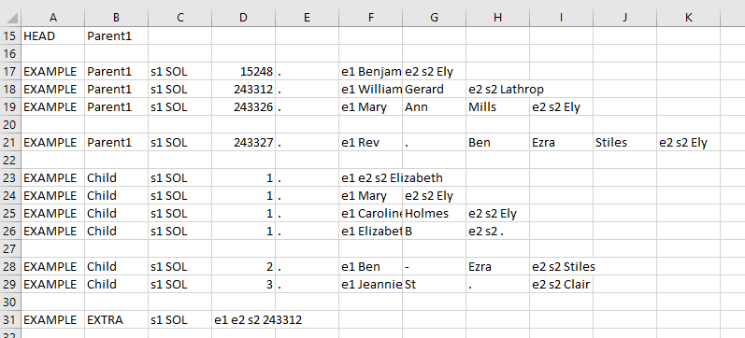
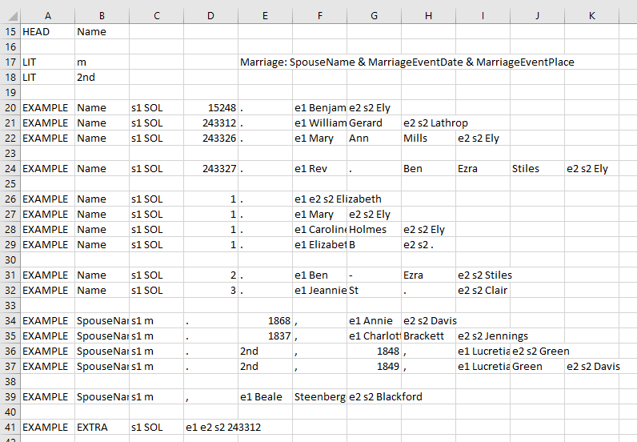
GreenQQ UI (Family)
Family
Marriage (partial)
Notes:
The four Parent1 templates in Family and the first four Name templates in Marriage are inherited and thus require no clicks to create.
The six Child templates require three clicks, one for the first four using assumed format variants for children names and two for the two names whose patterns are not in the assumed name variants.
EXTRA comes for free (for both Family and Marriage).
Since children can have spouses in the general Family book type, the Child templates in Family are included as Name record-head templates in Marriage (no additional clicks needed).
Since we have three patterns for marriages, 1st and 2nd marriages with event dates and a marriage without an event date and since spouse names have two format variants, only one click for each of the three patterns is needed to get the five SpouseName templates templates.
6 clicks for 27 templates

Slide 25
GreenQQ UI (Family)
…
Harriet Clarissima El
Rev. Ben Ezra Stiles
Clara Vanola Major
Mamie Anna Souder
Vitals
Beale Steenberger B
Thomas Ely
Jeannie St. Clair
Ben-Ezra Stiles
1817
Birth Place
Christening Date
Christening Place
Birth Date
1871
Death Place
Burial Date
Burial Place
Death Date
Harriet Clarissima El
Clara Vanola Major
Marriage Event Date
Marriage Event Place
Spouses
Rev. Ben Ezra Stiles
Mamie Anna Souder
Thomas Ely
Beale Steenberger B
Jeannie St. Clair
Spouse Name
Ben-Ezra Stiles
Harriet Clarissima El
Parent 1
Parent 2
Rev. Ben Ezra Stiles
Parents
Clara Vanola Major
Mamie Anna Souder
Beale Steenberger B
Notes:
Household Names are all inherited.
One click for BirthDate and one for DeathDate.

Slide 26
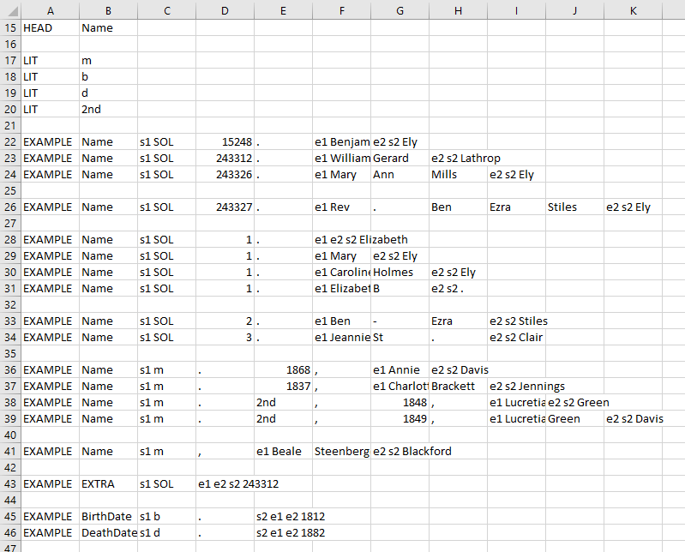
GreenQQ UI (Family)
Person
Notes:
2 clicks for 18 templates

Slide 27
GreenQQ UI (Family)
…
Harriet Clarissima El
Rev. Ben Ezra Stiles
Clara Vanola Major
Mamie Anna Souder
Vitals
Beale Steenberger B
Thomas Ely
Jeannie St. Clair
Ben-Ezra Stiles
1817
Birth Place
Christening Date
Christening Place
Birth Date
1871
Death Place
Burial Date
Burial Place
Death Date
Harriet Clarissima El
Clara Vanola Major
1848
Marriage Event Place
Spouses
Rev. Ben Ezra Stiles
Mamie Anna Souder
1873
Thomas Ely
Beale Steenberger B
Marriage Event Date
Jeannie St. Clair
Spouse Name
Ben-Ezra Stiles
Harriet Clarissima El
Parent 1
Parent 2
Rev. Ben Ezra Stiles
Parents
Clara Vanola Major
Mamie Anna Souder
Beale Steenberger B
Notes:
Household Names are all inherited.
One click for BirthDate and one for DeathDate (these complete Marriage)

Slide 28
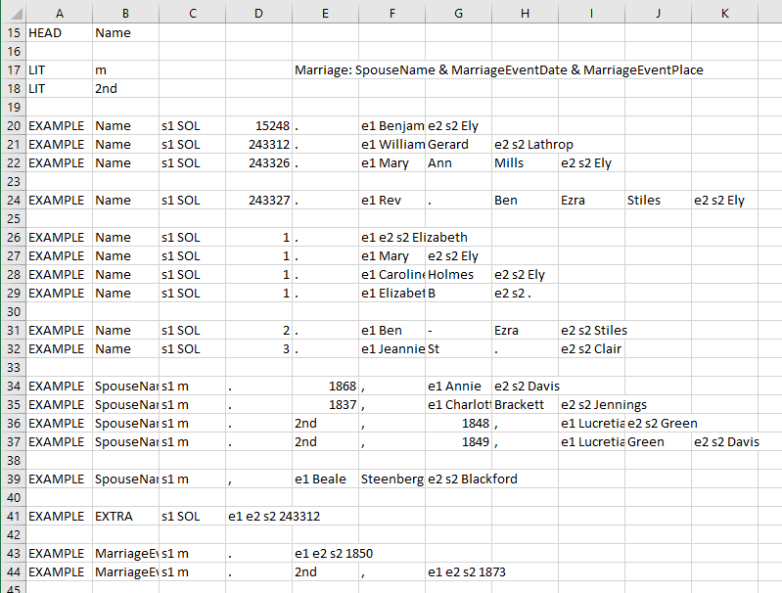
GreenQQ UI (Family)
Marriage
Notes:
Two patterns for MarriageDates and thus two clicks (all others were already there)
2 clicks for the 2 additional templates, 18 altogether.

Slide 29
GreenQQ UI (Family)
…
Harriet Clarissima El
Rev. Ben Ezra Stiles
Clara Vanola Major
Mamie Anna Souder
Vitals
Beale Steenberger B
Thomas Ely
Jeannie St. Clair
Ben-Ezra Stiles
1817
Birth Place
Christening Date
Christening Place
Birth Date
1871
Death Place
Burial Date
Burial Place
Death Date
Harriet Clarissima El
Clara Vanola Major
1848
Marriage Event Place
Spouses
Rev. Ben Ezra Stiles
Mamie Anna Souder
1873
Thomas Ely
Beale Steenberger B
Marriage Event Date
Jeannie St. Clair
Spouse Name
Ben-Ezra Stiles
Harriet Clarissima El
Thomas Patterson
Jane Clark
Rev. Ben Ezra Stiles
Rev. Ezra Stiles Ely
Deborah A. Beatty
Parents
Clara Vanola Major
Parent 1
Parent 2
Mamie Anna Souder
Beale Steenberger B
Notes:
Household Names of Heads and HeadSpouses are inherited.
The format variant for Parent names is the same as for household Head names. Thus, since Rev. Ezra Stiles Ely is the only non-standard Parient1 name, two clicks is sufficient for Parent1; likewise, two clicks for Parent2 since Deborah A. Beatty is the only non-standard Parent2 name.
Although Parent2 persons appear to all be introduced with a simple “and”, it may be best to build templates back to the “dau. of” and “son of” parent indicators (which is the default). This does not cause additional clicks, it just means that have a cross product of all Parent1 and Parent2 names in the templates.

Slide 30
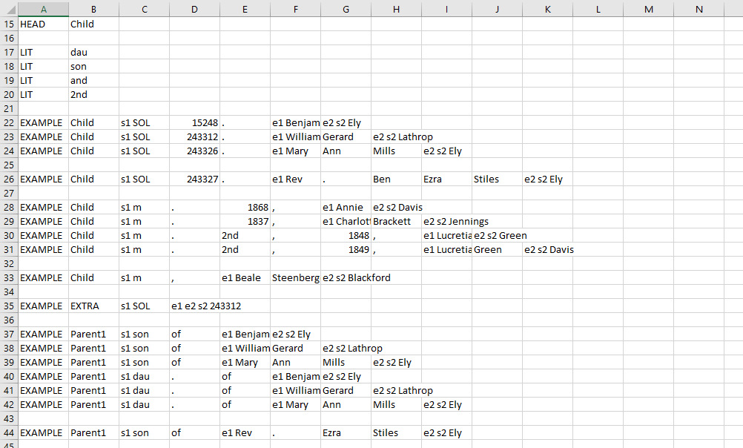
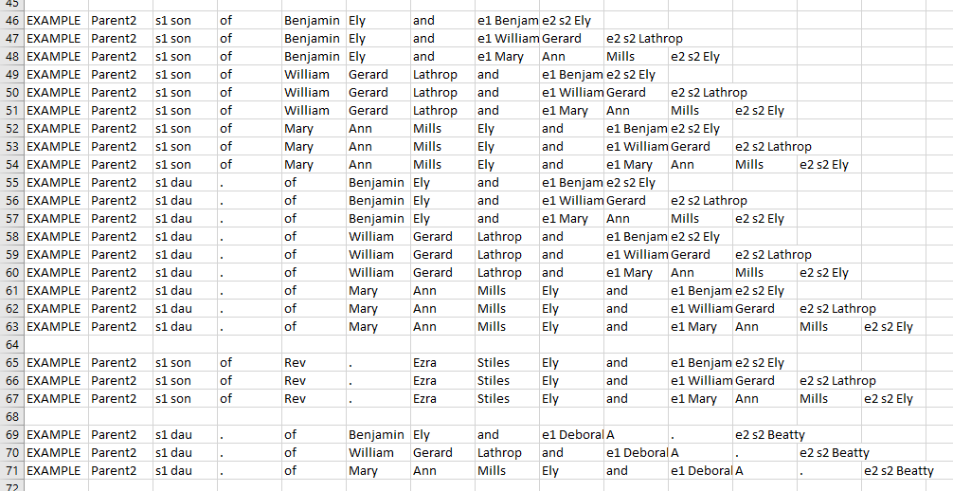
GreenQQ UI (Family)
ChildOf
Notes:
The Child templates and the EXTRA template are inherited (no clicks).
With two LITs (son of & dau. of) and three format variants for parent names, we get 9 standard templates for Parent1 and 18 for Parent2. In addition, for the non-standard name, Rev. Ezra Stiles Ely, we have one non-standard Parent1 template three non-standard Parent2 templates, and for the non-standard name Deboara A. Beatty, we have three non-standard Parent 2 templates.
4 clicks for the 31 additional templates, 41 altogether
Altogether: 16 clicks for 108 templates.

Slide 31
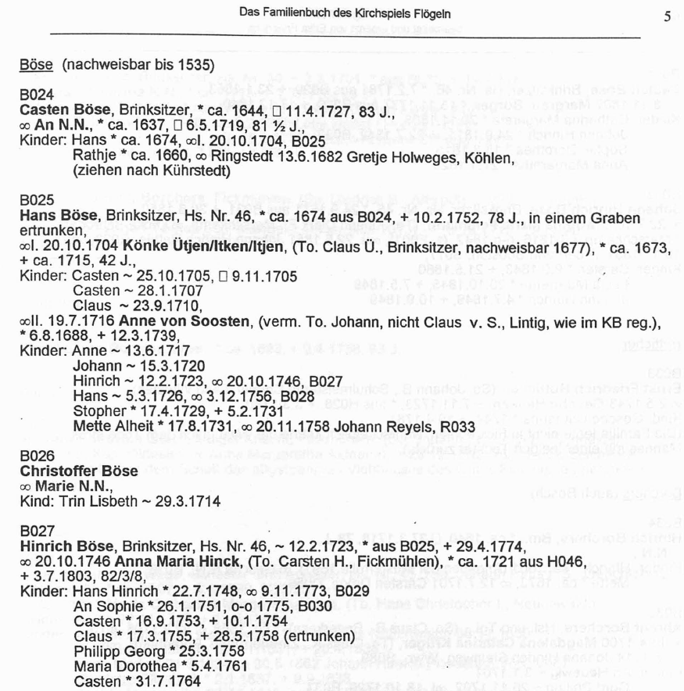
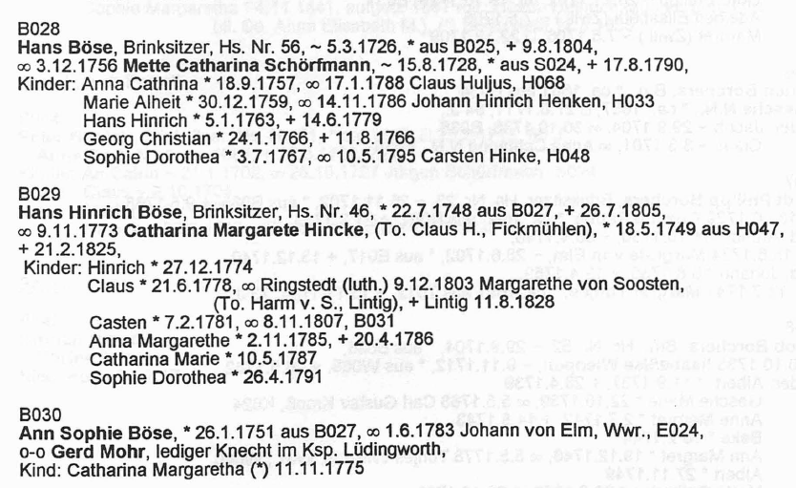
GreenQQ UI (Family+BySpouse+Individual+ReferenceID)
B024
Casten Böse
B024
Reference ID
Head Name
Casten Böse
Spouse Name
Child
Household Members
Casten Böse
Birth Date
Birth Place
Christening Date
Christening Place
Death Date
Death Place
Burial Date
Burial Place
Vitals
Casten Böse
Spouse Name
Marriage Event Date
Marriage Event Place
Other Spouses
Casten Böse
Parent 1
Parent 2
Other Parents
Notes:
Global strategy: (1) partition the book into households, (2) establish the household parents and children, (3) gather the information about each household member, and (4) add any mentioned non-household persons along with any information about them; (e.g. Margarethe von Soosten along with her father, DeathPlace and DeathDate).
Entity Recognizer! (We must postprocess to generate records.) Templates for person names automatically trickle down and can only be entered.
Format variants for full person names, allow us to only click on Casten Böse to get all the head names. We’ll also have format variants for household spouse names (in this book it is the same as for head spouses); and we have a set of given-person-names format variants to allow us to pick up all the household children names.
Because we will later have the possibility of run-away spouse and children lists, we also generate a stopper. (In books with ReferenceID, one family will not run over into the next if we stop when we encounter a ReferenceID.
Results after clicks on B024 and on Casten Böse. (With SOL, EOL, and predefined SearchPhrase tokens, we should be able to generate best-guess templates automatically. We likely need to allow users to edit them by extending or shortening right and left context. For Aggregate Grouping Identifiers, we should add additional left context, as appropriate: for Reference ID include the preceding blank line; for Head Name, include the preceding reference identifier.)
To prevent one family from running into the next we add a stopper whenever possible; these stoppers are sometimes also useful for preventing one persona’s space from running into the next persona and are especially useful when we have embedded Individual records as we do in Family+Individual. When we have reference IDs like we do here, these are ideal stoppers, and we set them automatically.

Slide 32
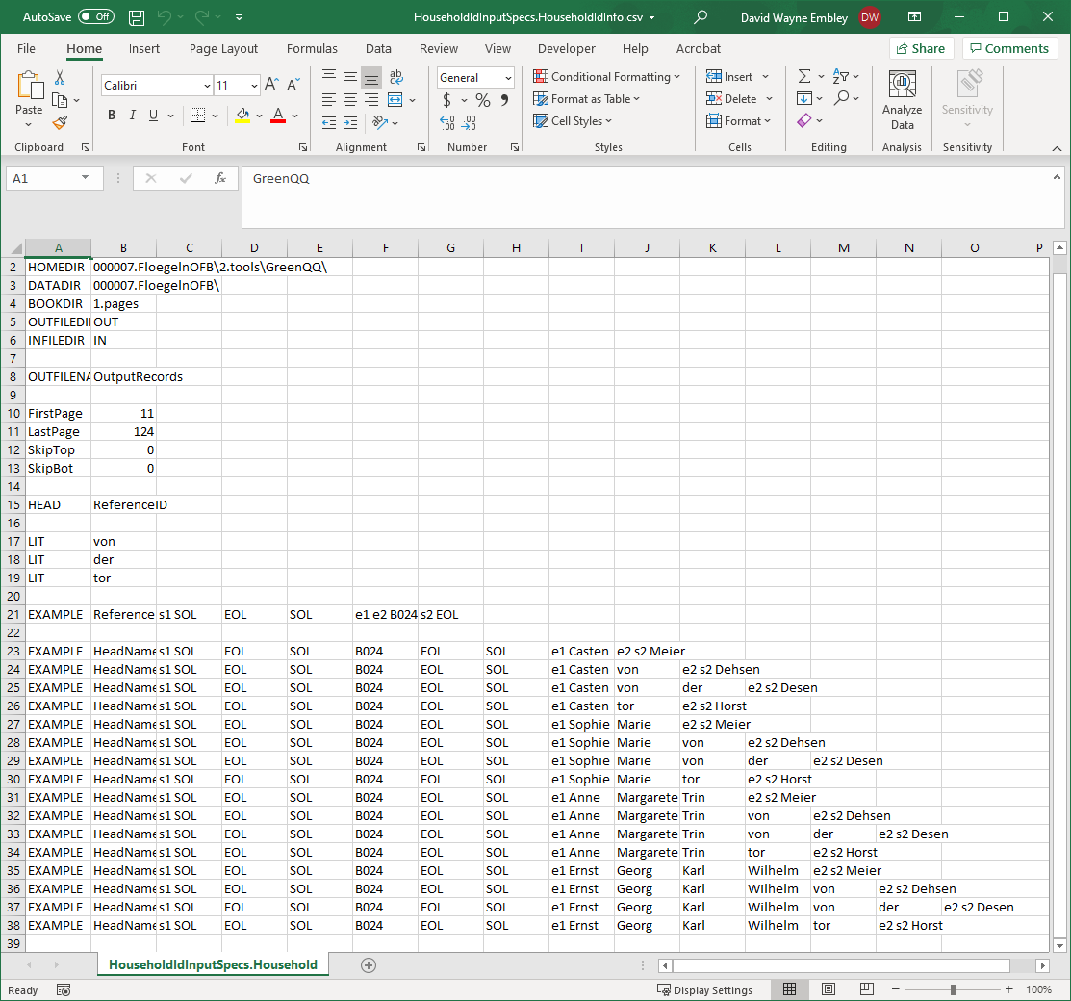
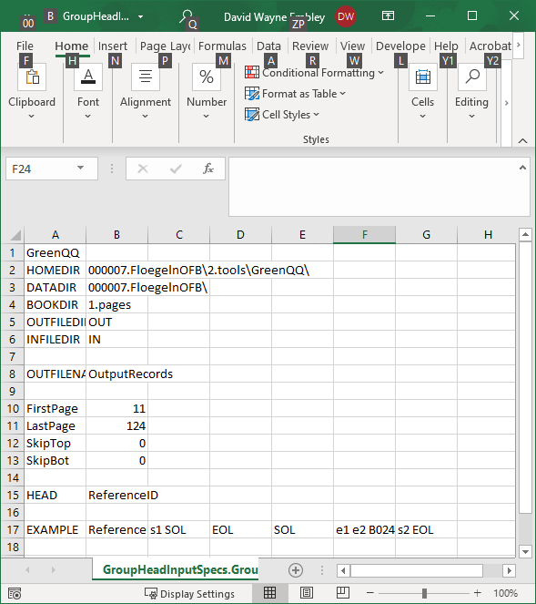
GreenQQ UI (Family+BySpouse+Individual+ReferenceID)
HouseholdId
GroupHead
Notes:
These two GreenQQ template csv documents are created with the two clicks:
Path information is provided by the system.
Whoever sets up the job for the book specifies the page information.
For each record type, the HEAD is the first field in the layout.
The click on B024 when the focus is on “Reference ID” generates the template in line 17 of GroupHead.
The click on Casten when the focus is on “Head Name” generates the templates in lines 23-38 of HouseholdId and generates the LITs in lines 17-19. (Format variants are prespecified by whomever sets up the job for the book.)
These two clicks also appropriately generate templates and LITs for all the other csv documents (to be completed later).

Slide 33
GreenQQ UI (Family+BySpouse+Individual+ReferenceID)
…
Casten Böse
Anna Maria Hink
Hans
Household
An
Rathje
Könke Ütjen/Itken/I
Trin Lisbeth
Gerd Mohr
Child
Spouse Name
Casten Böse
Anna Maria Hink
Vitals
An
Könke Ütjen/Itken/I
Gerd Mohr
Hans
Rathje
Trin Lisbeth
Birth Date
Birth Place
Christening Date
Christening Place
Death Date
Death Place
Burial Date
Burial Place
Casten Böse
Spouse Name
Marriage Event Date
Marriage Event Place
Anna Maria Hink
Spouses
An
Könke Ütjen/Itken/I
Gerd Mohr
Hans
Rathje
Trin Lisbeth
…
Notes:
After clicks on Anna Maria Hink (using format variants to account for all but An and Könke Ütjen/Itken/Itjen); and then on An and Könke Ütjen/Itken/Itjen to get the non-format-variant SpouseNames; and then on Gerd Mohr to get the pattern variation that has no marriage date; and clicks on Hans for the “Kinder” pattern, on Rathje for the “TAB” pattern, and on Trin Lisbeth for the “Kind” pattern.
STOP also comes into play here, but it has already been generated by a click on Reference ID in the aggregate grouping record type. (Internally, STOP becomes EXTRA.)
Note that all SpouseName templates and all Child templates automatically propagate to other record types (indeed that’s the only way to get these record heads into their respective records).

Slide 34
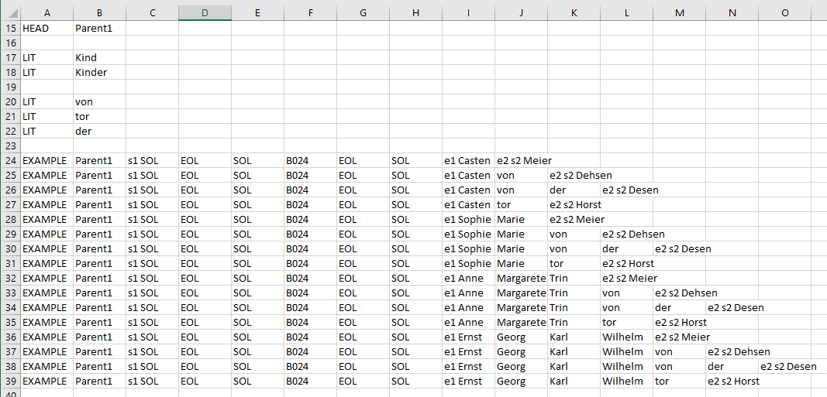
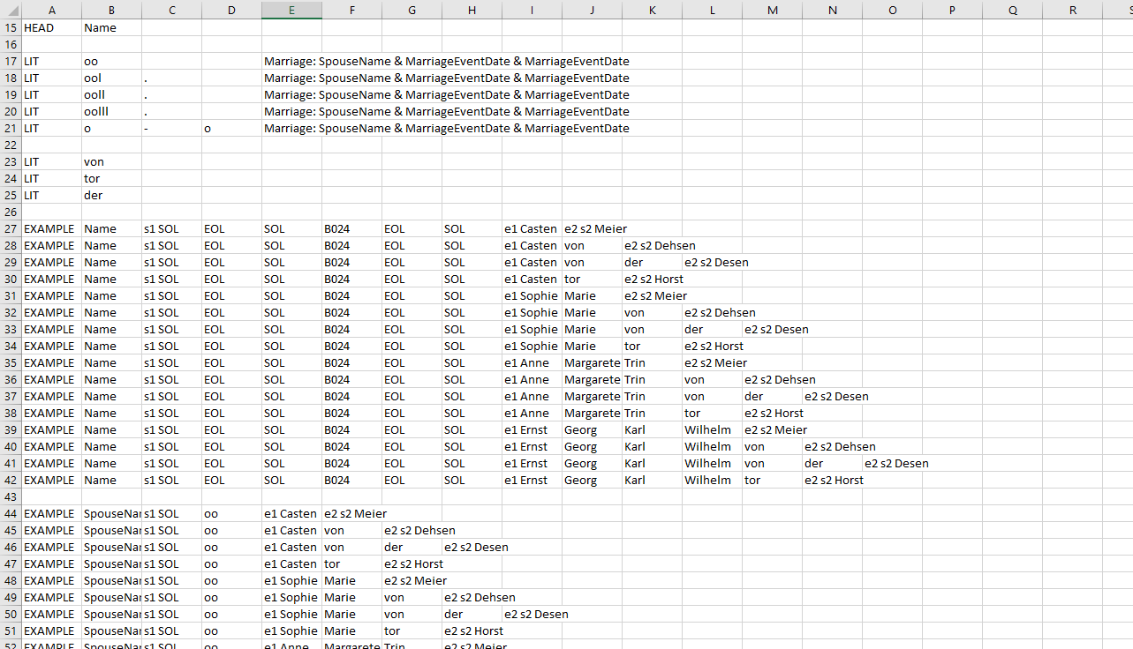
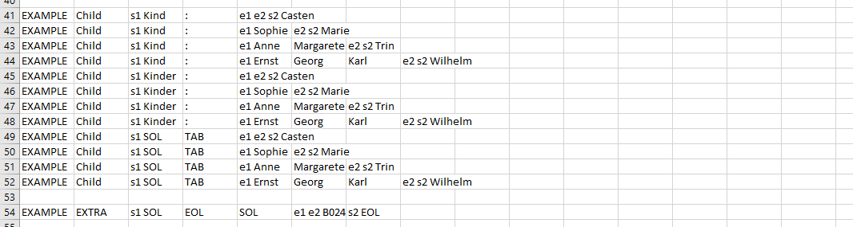
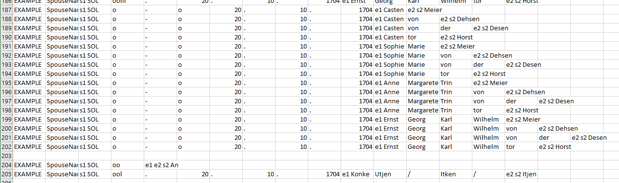
GreenQQ UI (Family+BySpouse+Individual+ReferenceID)
Marriage.HeadSpouse(s)
Family
Notes:
These two GreenQQ template sets (one for Family, and the other for Marriage (of HeadSpouse(s))) are created by seven additional clicks:
The Parent1 templates in the Family record type and the Name templates in the Marriage.HeadSpouse(s) record type had already been created by the two clicks for creating the grouping and household-head templates. Likewise STOP has also been created by the click on Reference ID
The Child templates in Family are a cross-product of the three different Child-SearchPhrases and the four child format variants, yielding 12 templates.
Two of the four clicks to obtain the SpouseName templates in Marriage(of household spouses) yield a cross-product of the two patterns (with and without marriage date), the five marriage-symbol LITs, and the16 household spouse format variants (160 templates) and then also two more templates, one for An and the other for Könke.
Altogether 178 templates generated by 7 clicks (and, BTW, no adjustments required either).
At this point the Marriage.HeadSpouse(s) template set is not complete – it doesn’t yet include the dates and places of the marriage (to be picked up later)

Slide 35
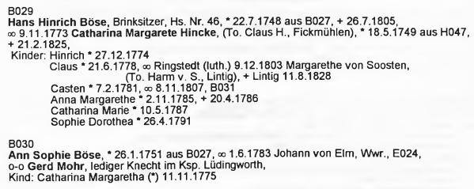
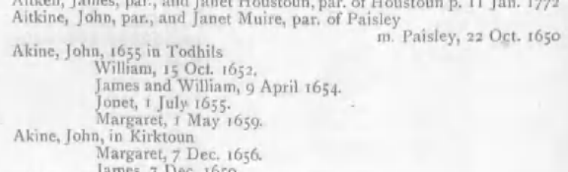
GreenQQ UI (Family+BySpouse+Individual+ReferenceID)
Person, Marriage, ChildOf, and Individual records in Semi-structured Documents:
Notes:
Forms (record types) Person, Marriage.OtherSpouse(s), and ChildOf (also Individual for Family+Individual) are for gathering the information for the household members: vitals and relationships.
Records are created from the intervening text between household-member names. Indeed, this is our invariant constraint for determining the semi-structuredness condition a document must satisfy to be processible by us.
Basically, it works: FD fields (birth, death) directly recognized (none are outside the boundary); one-hop (parents, other spouses) relationships likewise.
Issues (the “gotcha’s”):
Missing heads: run-away lists (spouses and children)
Overlapping record information: imagine a second spouse for Hans “oo Marie Meier”
Nested records
Combined records

Slide 36
GreenQQ UI (Family+BySpouse+Individual+ReferenceID)
Person, Marriage, ChildOf, and Individual records in Semi-structured Documents:
oo 7.14.1796 Marie Meier
Name,5,53,2,1,James
Name,5,53,4,1,William,ChristeningDate,5,53,6,3,9,April,1654
Notes:
Forms (record types) Person, Marriage.OtherSpouse(s), and ChildOf (also Individual for Family+Individual) are for gathering the information for the household members: vitals and relationships.
Records are created from the intervening text between household-member names. Indeed, this is our invariant constraint for determining the semi-structuredness condition a document must satisfy to be processible by us.
Basically, it works: FD fields (birth, death) directly recognized (none are outside the boundary); one-hop (parents, other spouses) relationships likewise.
Issues (the “gotcha’s”):
Missing heads: run-away lists (spouses and children); e.g., Gerd can become Hans’s spouse and Margaret can become John Aitkine’s child. Solution: STOPpers on household heads and reference IDs auto-generated.
Overlapping record information: imagine a second spouse for Hans “oo Marie Meier”, now “oo 7.14.1796” is in Sophie’s record space and will look like her spouse. Solution: STOPpers on marriage symbols auto-generated for OtherSpouse(s).
Nested records: (1) Margarethe’s father and death info and (2) Johann’s prior marriage to his now-deceased spouse. Solution: nested Individual records denoted by cap-relationship name of record head (SPOUSE for both these, but could also be PARENT1, PARENT2, or CHILD) and then literally copied out of the record and reset as an Individual record; the original record is modified by changing SPOUSE to SpouseName (PARENT1 -> Parent1, …) and the rest of the copied information deleted. In Individual the field names are respectively Parent1, and DeathPlace, DeathDate (for Margaret) and SpouseName (for Johann).
Combined records: The records for James and William are on the same page (5) and line (53) with only one token between them and that James has no associated field. Solution: heuristically create two records by giving both all the field info (works for triplets too).

Slide 37
GreenQQ UI (Family+BySpouse+Individual+ReferenceID)
B024
Casten Böse
B024
Reference ID
Head Name
Casten Böse
Anna Maria Hink
Hans
Household
An
Rathje
Gerd Mohr
Trin Lisbeth
Könke Ütjen/Itken/I
Child
Spouse Name
Casten Böse
Margarethe von Soo
Anna Maria Hink
SPOUSE
An
CHILD
Könke Ütjen/Itken/I
PARENT1
Gerd Mohr
Hans
PARENT2
Vitals
Rathje
STOP
Trin Lisbeth
ca. 1644
Birth Place
25.10.1705
Christening Place
6.8.1688
Christening Date
Birth Date
10.2.1752
Lintig
11.4.1727
Burial Place
ca. 1715
Death Place
Burial Date
11.8.1828
Death Date
…
Notes:
Household member names serve as a partitioning mechanism to separate vital information about individuals.
The household persons come from previous records (indeed, they can only come from previous records) – so no clicks required.
BirthDates are in standard form and in “ca” form and the default SearchPhrase applies – left context up to and including the defining LIT (two clicks); ChristeningDates and BurialDates are all standard and need only the default SearchPhrase (one click each); DeathDates are standard and need only the default SearchPhrase, but there are two patterns – with and without a place name (e.g., Lintig for one of the DeathDates) (three clicks); there is only one place – a DeathPlace (one click). (Note that both * and (*) are BirthDate LITs; thus, the user need not have to separately make templates for both, so that a templated for “(*) 11.11.1775” need not be added by yet one more click.)
The default SearchPhrase for Place, in addition to the standard left context (back to the LIT) also includes right context beyond the Extract to the first non-white-space/non-alpha token. (For Lintig, the right context extends to “11”.) Place names are typically a sequence of one or more capitalized names – and thus are the same as given names; without the right context requirement the lexical analyzer that classifies them often fails.
Margarette von Soosten is a non-household person who has vital information (her birthplace and birthdate). We capture added information for all “+Individual”’s in the same way: (1) label them with cap labels (SPOUSE, CHILD, PARENT1, PARENT2) depending on their relationship to the person in whose record they are nested (e.g., Margarette von Soosten is the SPOUSE of Claus) and (2) we parse the information that belongs to them as a nested Individual record. (We can and do also capture records nested inside of nested records.)
Note that ca. 1721 is Anna Maria Hinck’s birth date, so we should not make Carsten H. a cap PARENT1. (Tricky: a patron could look at H046 to see for sure, although seeing that Anna would be 25 at the time of her marriage, it would not be reasonable that 1721 would be the father’s birth year.)

Slide 38
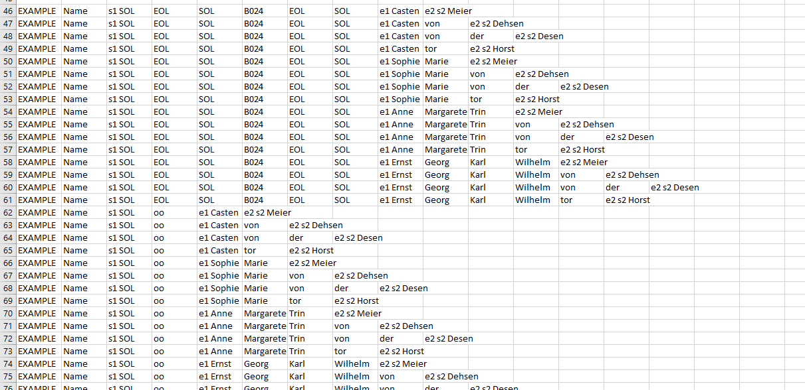
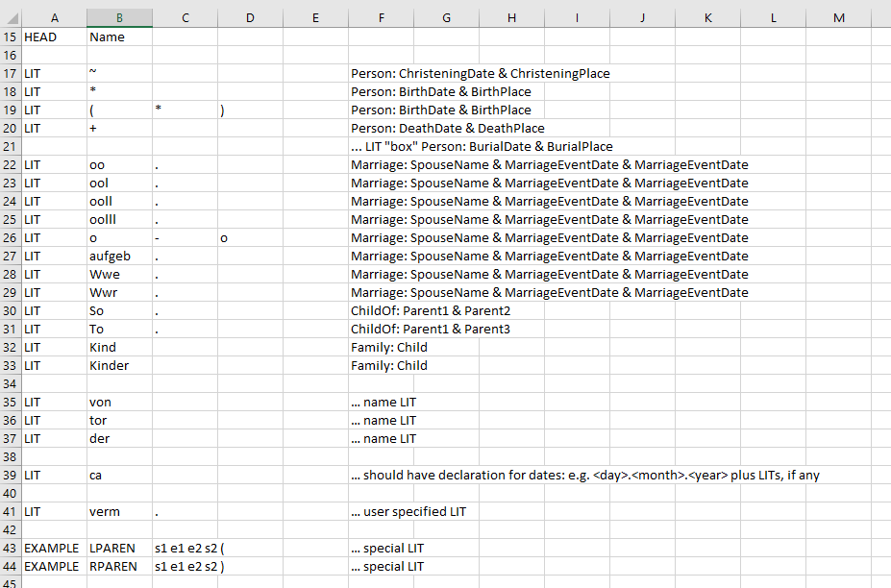
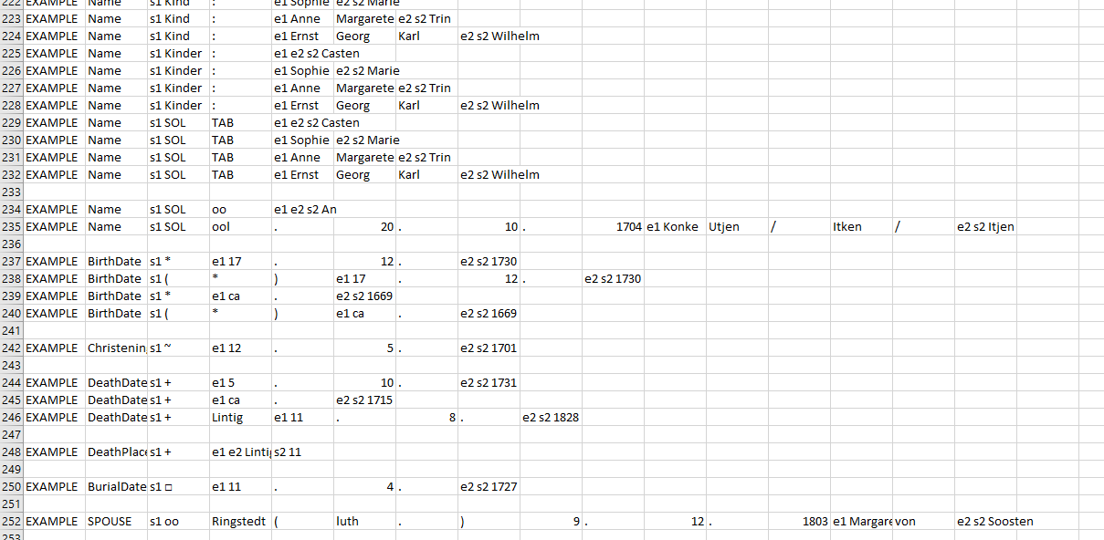
GreenQQ UI (Family+BySpouse+Individual+ReferenceID)
Person
Notes:
LITs are associated with record fields (lexical object sets).
For Person we need Marriage, ChildOf, and Child LITs to allow for CAP Individuals. (The additional Marriage LITs “aufgeb.” “Wwe.”, “Wwr.” are only needed for CAP Individuals, not household spouses.)
For dates, we should have regular-expression format variants defined ahead of time. (In this case, we would not need to have pattern variations for dates like “1775”, “Dez. 1775”, “10 Dez. 1775” which occasionally appear or even for “ca. 1775”.)
LITs like “verm.” and “mögl.” should likely be defined by the user. (How do we provide for this in the interface?)
Nested record extents are dictated by parentheses, record heads, and STOP. Record types that can provide for non-household Individuals, always include them by default.
186 of these 196 templates are created from previous record types. Only 9 clicks are required to create them all. (Three of the ten new templates are for BirthDate which has two LITs -- * and (*). If we were to include regular-expression-defined dates, the two clicks for the “ca.” templates could be eliminated.)
Although I’ve added “verm.” as a LIT, we don’t use it here. (I just didn’t want to forget that we sometimes do need literals that are patron specified.)

Slide 39
GreenQQ UI (Family+BySpouse+Individual+ReferenceID)
…
Casten Böse
Margarethe von Soo
Anna Maria Hink
SPOUSE
An
CHILD
Könke Ütjen/Itken/I
PARENT1
Hans
Vitals
Rathje
PARENT2
Trin Lisbeth
STOP
ca. 1644
Birth Place
25.10.1705
Christening Place
6.8.1688
Christening Date
Birth Date
10.2.1752
Lintig
11.4.1727
Burial Place
ca. 1715
Death Place
Burial Date
11.8.1828
Death Date
Casten Böse
B025
20.10.1704
Ringstedt
Johann von Elm
Anna Maria Hink
Gretje Holweges
13.6.1682
Marriage Event Place
SPOUSE
An
Johann Reyels
1775
CHILD
Spouses
Könke Ütjen/Itken/I
B030
9.12.1803
Gerd Mohr
Johann Hinrich Henk
Marriage Event Date
PARENT1
Hans
Margarethe von Soo
PARENT2
Rathje
E024
B024
Trin Lisbeth
Spouse Name
oo
STOP
…
Notes:
Household marriages, former marriages of household parents, and marriages of household children are intermixed and are syntactically separable by head-to-head partitioning. Hence, we separate them by creating two template sets – one for household marriages and one for other marriages of household members that appear in their information space. This requires that these two marriage types be syntactically identifiable. In Flögeln household marriages are identified by having marriage symbols on SOL boundaries and other marriages in-line. (Unfortunately, when one line wraps to the next, some in-line marriage symbols appear on the left margin; these should be identified and fixed (TAB indent or move to the end of the previous line).
We get the B024 STOPper for free (no clicks). In Flögeln this serves well to stop the last child from picking up a marriage in the next family.
One might think that ordinary head-to-head partitioning would separate one persona’s marriage information from the next persona’s marriage information. (Unfortunately, this property does not hold in Flögeln – see next comment for a resolution.)
Not only do we have format variants for person names, but we also have LIT variants for SearchPhrase symbols (here, so that we do not have to specify templates for each different marriage symbol). This one, however, does require a click on any one of the marriage symbols. Note that I’m not suggesting highlights for STOPpers (if we want STOPper highlights, I’d suggest red horizontal lines for household ID STOPpers and red vertical lines for other STOPpers.)
OFBs have lots of left context variations for marriage info: several marriage symbols; places (omitted more often than not); dates (sometimes omitted); occasional commentary (e.g., verm., mögl., parenthetical remarks, …) (12 clicks required to get the “other” SpouseNames, MarriageEventDates, and MarriageEventPlaces; note for example that we need both Gretje Holweges and Johann Reyels because Gretje has a MarriageEventPlace and Johann does not; also since we don’t have format variants for names other than household names, the Johann Reyels pattern does not serve for the Johann Hinrich Henken pattern.) Note that we could decide to use format variants for other-spouse SpouseNames (and later also for other parents); one of the issues in FloegelnOFB is that the author uses a lot of abbreviations; another issue is the even greater proliferation of templates – more marriage LITs (and parent LITs, i.e., for mothers, and illegitimates, probable’s, …).
Johann von Elm is a spouse who has a former spouse; he is a widower from the household E024. As before, we mark him as a cap SPOUSE. Note that a SpouseName template could have been given that would label him as such instead of as a SPOUSE. To ensure he’s labeled correctly, we need to be able to pick up some right context. (Potentially, this could be automatic with the same rule as for place names – first non-name symbol after the extract; but still, we may need to provide a way for the patron to add right context.) Subtle point: although it doesn’t happen here, Johann von Elm could have been incorrectly labeled as a spouse and thus highlighted; the patron (1) must see that this is insufficient and relabel him as SPOUSE and (2) even if the patron sees this and creates a template to label him as a SPOUSE, if the patron does not extend the right context, other spouses that fit the pattern for Johann would be labeled as SPOUSE. (Even more subtle, but OK, is that this will merely result in a degenerate Individual with only a name and will be discarded AND the SPOUSE label will allow what should have been labeled SpouseName to properly be extracted.)

Slide 40
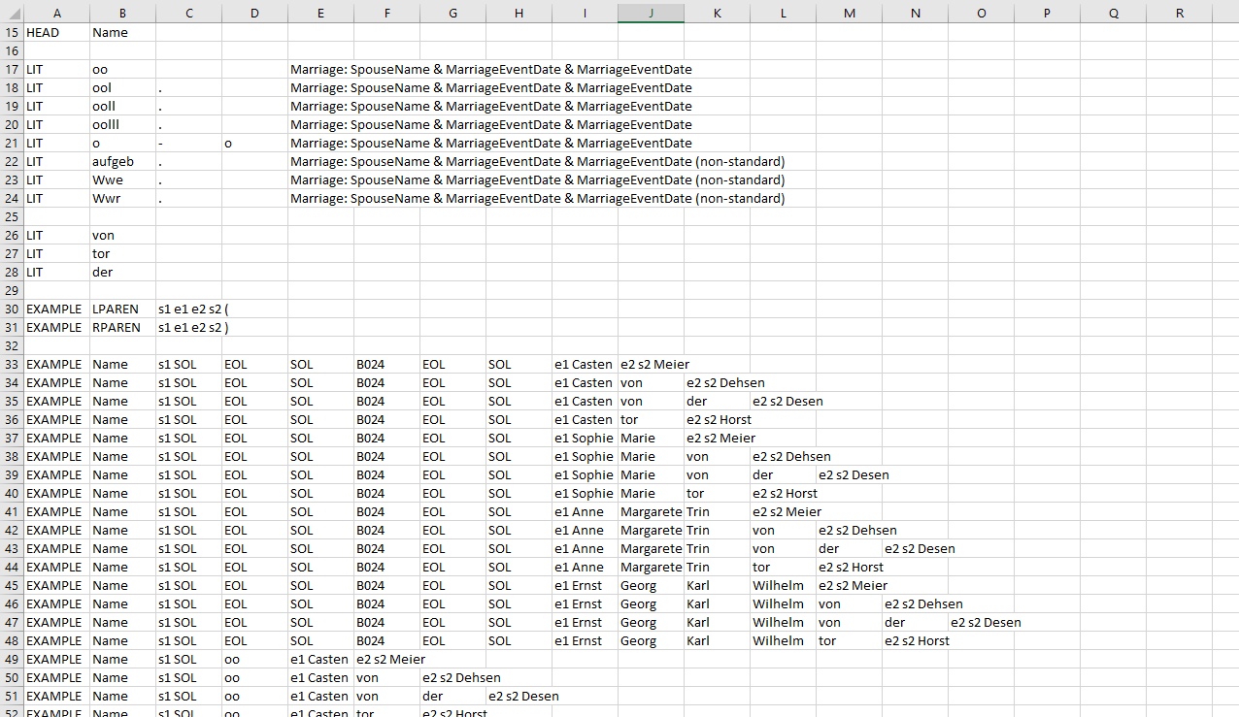
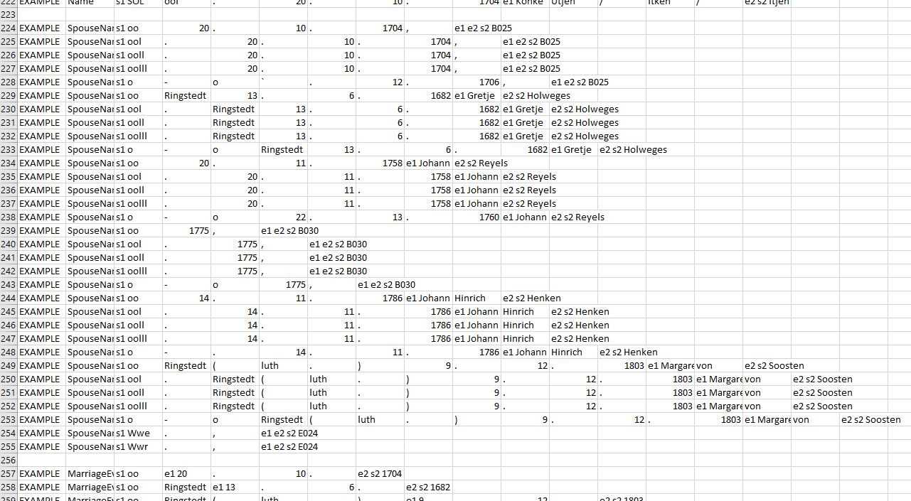
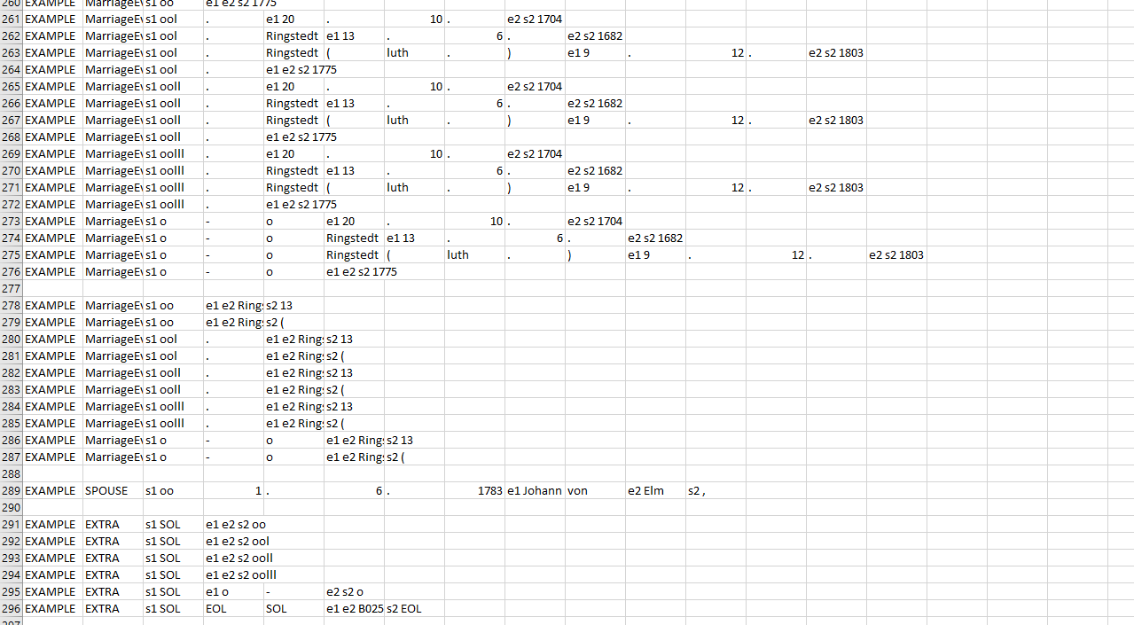
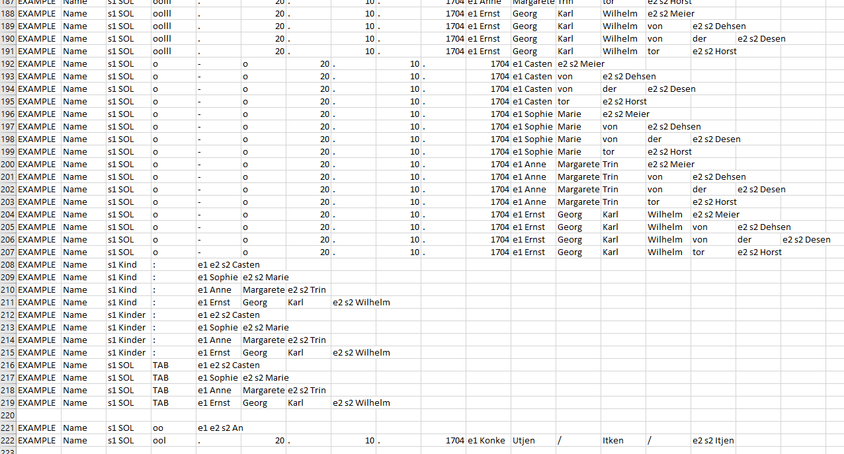
GreenQQ UI (Family+BySpouse+Individual+ReferenceID)
Marriage.OtherSpouse(s)
Notes:
In addition to generating Marriage.OtherSpouse(s) templates, MarriageEventDate and MarriageEventPlace templates are generated for Marriage.HeadSpouse(s). For page 015 these three templates are added:
EXAMPLE MarriageEventDate s1 SOL oo e1 9 . 11 . e2 s2 1773
EXAMPLE MarriageEventDate s1 SOL ool . e1 20 . 10 . e2 s2 1704
EXAMPLE MarriageEventDate s1 SOL ooll . e1 20 . 10 . e2 s2 1704
186 of these 255 templates are created from previous record types. Only 14 clicks are required to create them all.

Slide 41
GreenQQ UI (Family+BySpouse+Individual+ReferenceID)
…
ca. 1644
Birth Place
25.10.1705
Christening Place
6.8.1688
Christening Date
Birth Date
10.2.1752
Lintig
11.4.1727
Burial Place
ca. 1715
Death Place
Burial Date
11.8.1828
Death Date
Casten Böse
B025
20.10.1704
Ringstedt
Johann von Elm
Anna Maria Hink
Gretje Holweges
13.6.1682
Marriage Event Place
SPOUSE
An
Johann Reyels
1775
CHILD
Spouses
Könke Ütjen/Itken/I
B030
9.12.1803
Gerd Mohr
Johann Hinrich Henk
Marriage Event Date
PARENT1
Hans
Margarethe von Soo
PARENT2
Rathje
E024
B024
Trin Lisbeth
Spouse Name
oo
STOP
Casten Böse
B024
Parent 2
Margarethe von Soo
Anna Maria Hink
Claus Ü
SPOUSE
An
Johann
CHILD
Parents
Könke Ütjen/Itken/I
Harm v. S.
Hans
Parent 1
PARENT1
Rathje
PARENT2
Trin Lisbeth
B024
oo
STOP
Notes:
We get the household name templates and the marriage symbol and Reference ID STOPpers for free (no clicks).
The aus patterns for obtaining the head of household of the referenced family are all the same (one click).
There three patterns of names for To. (three clicks). For every To. template we also generate a So. pattern. (Note that both Anna Maria Hinck and Catharina Margarete Hincke have two Parent1s. Because Parent1 is functionally dependent, the second Parent1 will be omitted. There are no Parent2’s on this page; some appear in the book with a marriage symbol between Parent1 and Parent2.)
Margarethe von Soosten is a SPOUSE of Claus who has a Parent1 (one click).

Slide 42
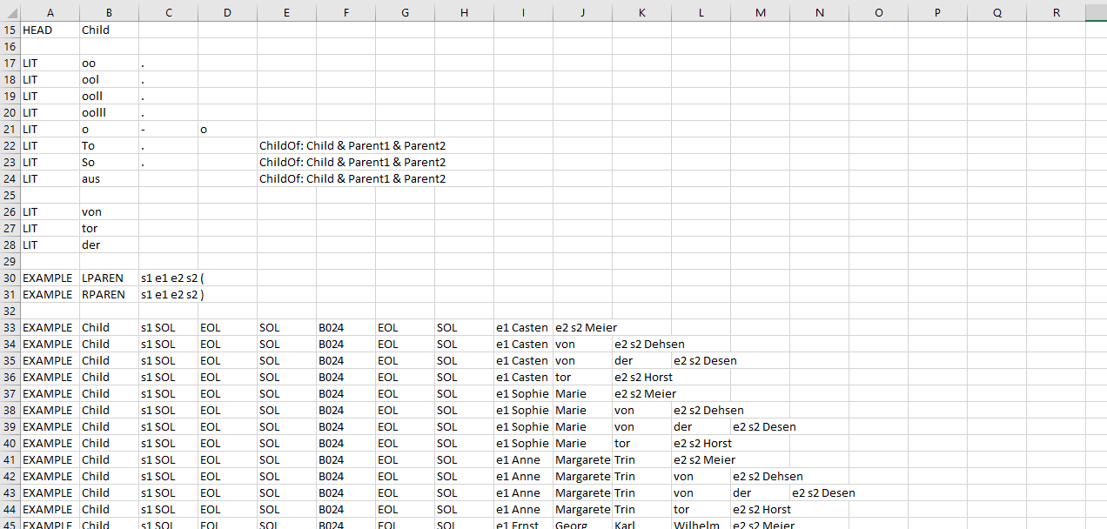
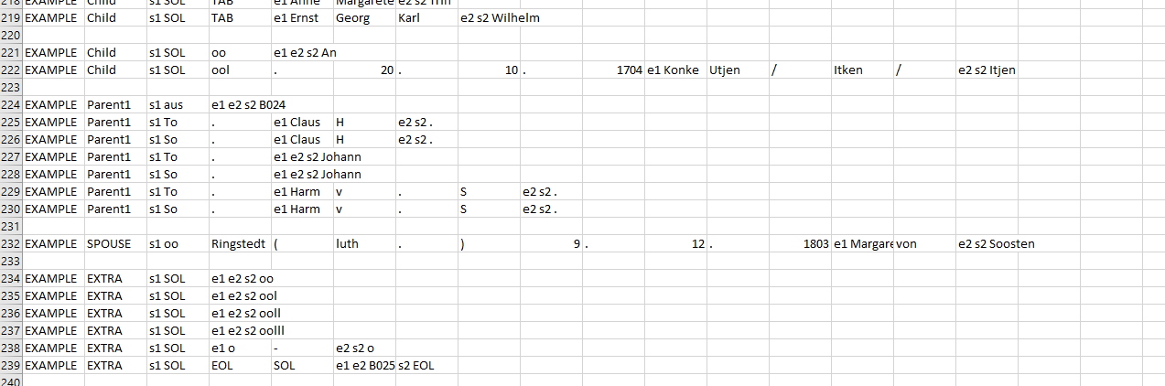
GreenQQ UI (Family+BySpouse+Individual+ReferenceID)
ChildOf
Notes:
186 of these 200 templates are created from previous record types. Only 5 clicks are required to create them all.
For each “To.” template we also create a “So.” template.
Altogether 879 templates were generated with 37 clicks. (No other user actions are required if we assume automatic right context generation in all questionable places, then, since no user-defined LITs, are needed.)
Once we have the ground truth finalized, we’ll get the PRF report on this.
Next, we need chase down missing heads with the aid of our reports and see how much work is required of the patron user and what the PRF results are. (We would like to at least extract persona records for all persons mentioned in the book who have any vital or one-hop relations – all for whom temple work can be performed.)

Slide 43
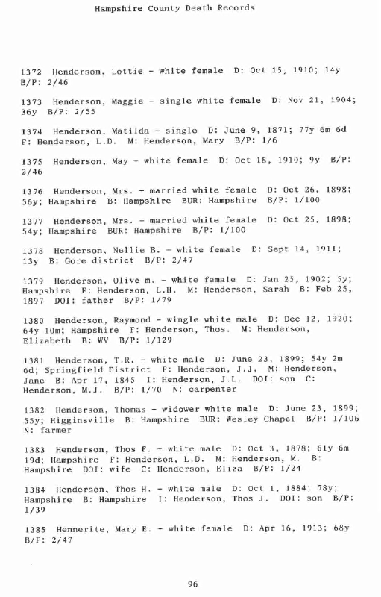
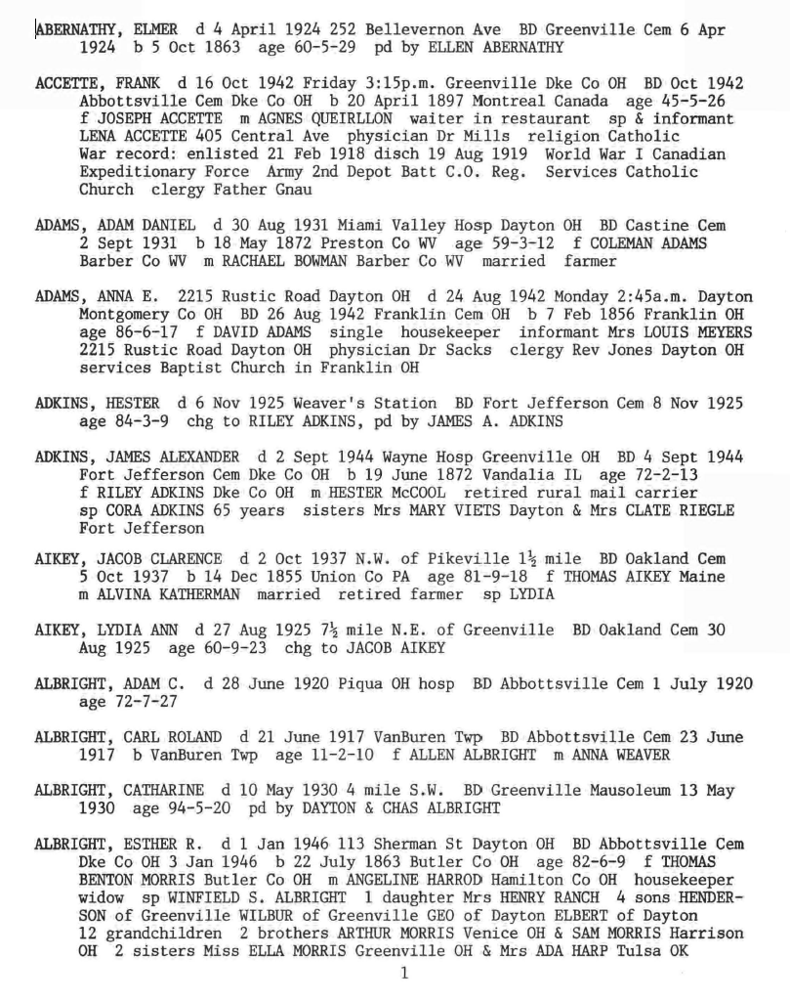
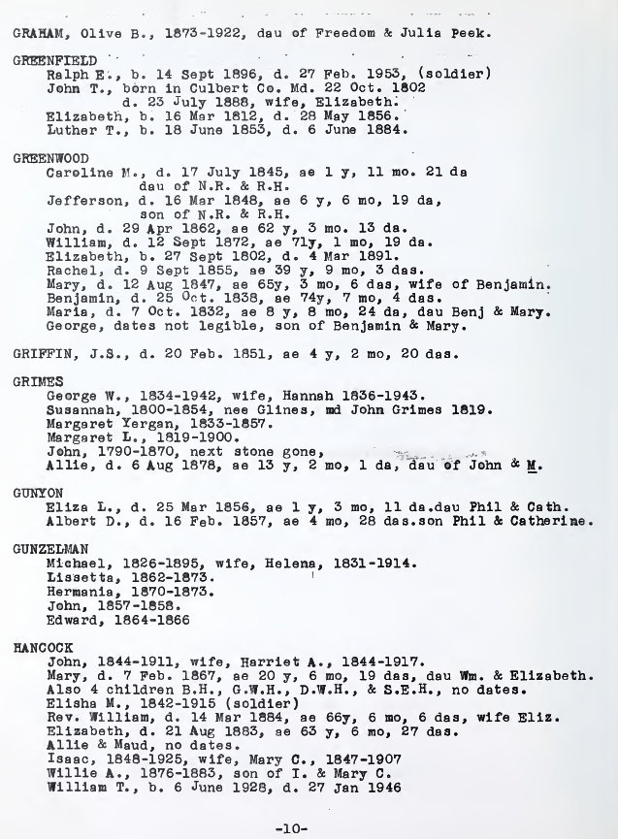
Individual Record Types
(Groups, Vitals, Relationships)
Individual (Hampshire)
Individual+Extra (Miller)
Individual+FactoredSurname (Butler)
Notes:
Variations
Individual+ReferenceID: group into individual records; vitals pertain only to the individual; relationships are all one-hop from the individual.
Individual+Extra: adds to Individual records the possibility of two-hop+ relationships (EXTRA relationships) but limits them to come spatially after vitals and one-hop relationships.
Individual+FactoredSurname: when individuals are listed alphabetically by surname, the surname is often factored out (like Butler but unlike Miller).
As before, we can have the +variations in any mix, and we can have Individual- missing either Vitals or Relationships but not both.

Slide 44
GreenQQ UI (Individual)
Henderson, Lottie
Henderson, Mrs.
Henderson, Olive m.
Head Name
Groups
Birth Date
Birth Place
Christening Date
Christening Place
Death Date
Death Place
Burial Date
Burial Place
Vitals
Spouse Name
Marriage Event Date
Marriage Event Place
Child
Parent 1
Parent 2
Relationships
Notes:
… for Individual, we should not use a stopper because it will prevent us from identifying missing heads (missing the primary person we’re interested in) … we still, however should recognize the index number as part of identifying the head
… the GroupHead is just an index number (not an ID that’s referenced) … it doesn’t matter what we call it for the GroupHead templates
… format variants for HeadName are assumed to include all those that appear here except the ones with titles (e.g., Mrs.); note the typo, the lower-case “m.”, which should be “M.” (and which we assume here has not been corrected.
… internally, we have four types of NUMs, NUM1or2, NUM3, NUM4, NUM5+; when it’s just a number, we should automatically generate all four. (We should have this case only when we working on GroupHead records.)
… we now have a cross-product on format variants and NUMs

Slide 45
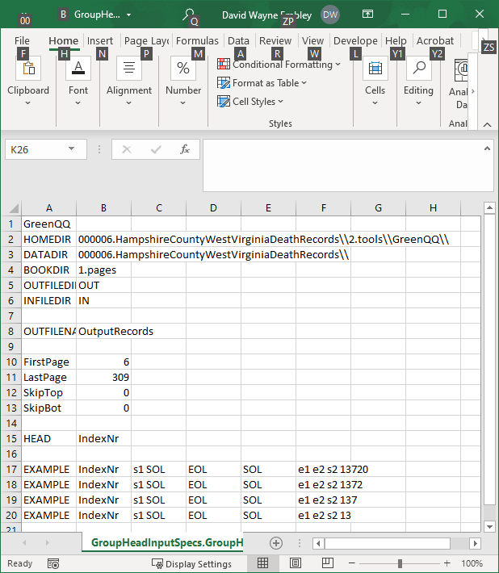
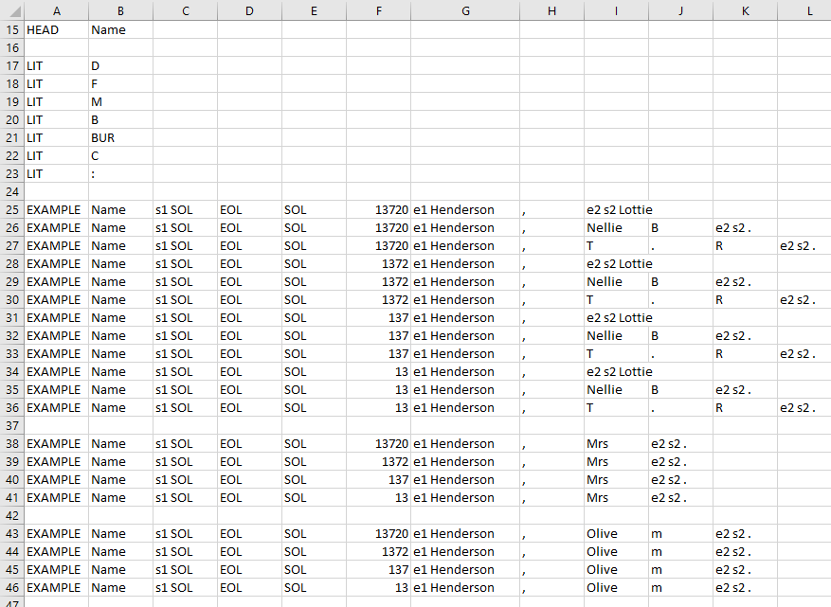
GreenQQ UI (Individual)
GroupHead
Individual
Notes:
… one click for GroupHead (just on STOP)
… 3 clicks for Individual to generate 24 templates for Individual
… Individual is partial at this point

Slide 46
GreenQQ UI (Individual)
Henderson, Lottie
Henderson, Mrs.
Henderson, Olive m.
Head Name
Apr 17, 1845
WV
Christening Date
Christening Place
Birth Date
Gore district
Hampshire
Vitals
Birth Place
Oct 15, 1910
Hampshire
Wesley Chapel
Burial Place
Death Date
Springfield District
Hampshire
Hampshire
Burial Date
Hampshire
Death Place
Spouse Name
Marriage Event Date
Marriage Event Place
Relationships
Child
Parent 1
Parent 2
Notes:
… only one format variant for dates
… I’ve ignored a PDFindexer error – no space in “Nov21, 1904” – assuming it would be fixed
… discovered an interesting issue: “F” is a literal denoting “Father” (although it really should be “F:”, which would solve the problem) and because “F” is a literal the Nellie pattern “| Henderson | , | Nellie | B | . |” doesn’t match with “| Henderson | , |Thos | F | .” … this problem should be fixed in GreenQQ … although I can’t see why the Nellie pattern does not match “| Henderson | , | Thos | H | . |” (“H” is not a literal), and it doesn’t match “| Henderite | , | Mary | E | . |” either … the Nellie template (T5) subsumes the Lottie template (T4: “| Henderson | , | Lottie | ) which it does match but the Nellie template, being longer, should take precedence
… we should retain the highlights on record heads for Individual when hovering over Vitals (and Relationships too)

Slide 47
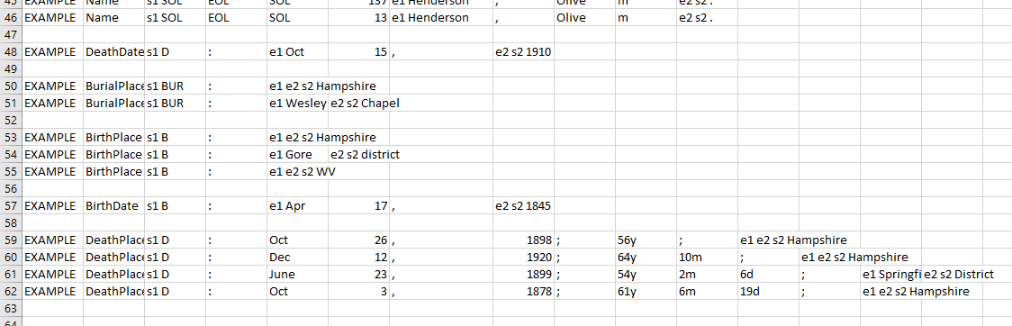
GreenQQ UI (Individual)
Individual
Notes:
… 11 clicks for 11 (dates have format variants – but only one appears hers – and places do not have format variants

Slide 48
GreenQQ UI (Individual)
Henderson, Lottie
Henderson, Mrs.
Henderson, Olive m.
Head Name
Apr 17, 1845
WV
Christening Date
Christening Place
Birth Date
Gore district
Hampshire
Vitals
Birth Place
Oct 15, 1910
Hampshire
Wesley Chapel
Burial Place
Death Date
Springfield District
Hampshire
Hampshire
Burial Date
Hampshire
Death Place
Henderson, Eliza
Marriage Event Date
Marriage Event Place
Spouse Name
Relationships
Henderson, M.J.
Child
Henderson, L.D.
Henderson, Mary
Henderson, Thos.
Henderson, M.
Parent 1
Parent 2
Notes:
… as expected, fewer templates needed for relationships because we don’t have a combination of dates and names, just names
… as before, for Individual, we should retain the highlighting of record heads when hovering on Relationships

Slide 49
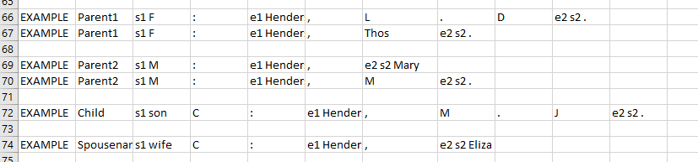
GreenQQ UI (Individual)
Individual
Notes:
… 6 clicks for 6 templates … here we could assume some format variants for names (but probably not for “Thos.”, but probably so for {Mary, M.} as Parent2 first names, which would reduce the number of clicks to 5
… altogether 20 clicks for 37 templates

Slide 50
GreenQQ UI (Individual+Extra)
ABERNATHY, ELMER
Birth Date
Birth Place
Christening Date
Christening Place
Death Date
Death Place
Burial Date
Burial Place
Spouse Name
Marriage Event Date
Marriage Event Place
STOP
Child
Parent 1
Parent 2
Notes:
… +EXTRA is for the possibility of a stopper for run-away children, which in Miller tend to run on to other relationships (moreover, there isn’t a good way to work with lists of children going back to the symbols that initiate them
... Given format variants, we need only one click to get all record head names

Slide 51
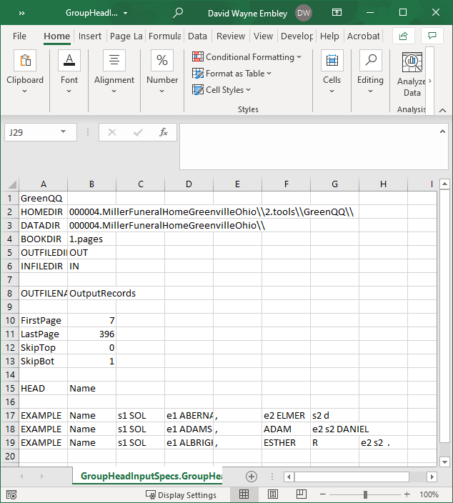
GreenQQ UI (Individual+Extra)
GroupHead
Notes:
… GroupHead part (to be evaluated for missing heads … statistics on the number on a page won’t likely help, but FDs over death dates will … other FDs are potentially useful to, but a bigger problem is giving back almost too much redundant information: we should find a way to consolidate whenever multiple FD failures over the same intersecting space are caught)
… all info before EXAMPLE should be preset as before
… format variants for head name are the three here <Surname>, <one or two given names where the second may be an initial> (Other common variants from the book are acceptable as well.)
1 click for 3 templates

Slide 52
GreenQQ UI (Individual+Extra)
ABERNATHY, ELMER
STOP
22 July 1946
Vandalia IL
Christening Date
Christening Place
Birth Date
Montreal Canada
Butler Co OH
Birth Place
1 Jan 1946
VanBuren Twp
1 Jan 1946
Abbottsville Cem Dk
Death Date
Wayne Hosp Greenv
13 May 1930
Greenville Mausoleu
Miami Valley Hosp D
8 Nov 1925
Fort Jefferson CemD
Greenville Dke Co O
26 Aug 1942
Fort Jefferson Cem
113 Sherman St Day
Oct 1942
Franklin Cem OH
Death Place
6 Apr 1924
Abbottsville Cem Dk
Burial Date
Greenville Cem
Burial Place
Spouse Name
Marriage Event Date
Marriage Event Place
STOP
Child
Parent 1
Parent 2
Notes:
… place names vary widely; those whose patterns are likely to appear elsewhere are picked up; those considered to be unique, e.g., N.W. of Pikeville 11/2 mile, are left for hand extraction in COMET. The default when we have a LIT designator is to make the pattern include all text back to the LIT; the user should include all place information including the address. (I’m surprised that places like “113 Sherman St Dayton OH” are correctly standardized (this as “Dayton, Montgomery, Ohio, United States”.) Failure to include all can interfere with template processing (e.g., if just “Dayton OH” in “Miami Valley Hosp Dayton OH” is picked up, GreenQQ template processing can end up splitting the name, labeling both “Miami Valley” and “Dayton OH” as DeathPlaces).

Slide 53
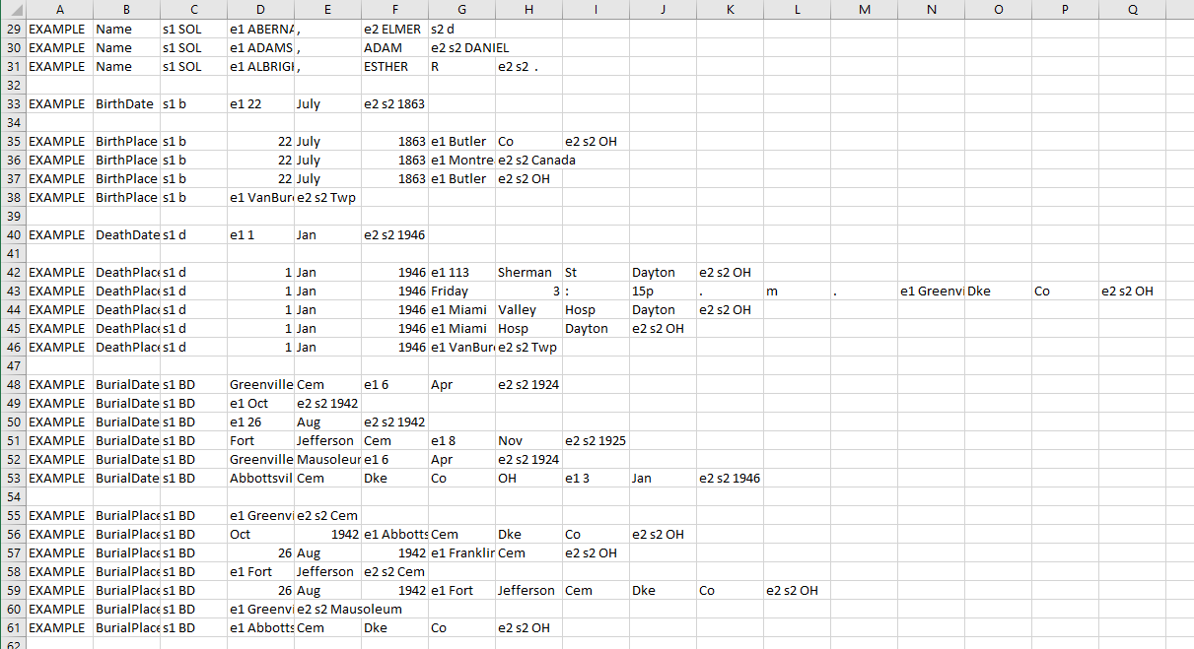
GreenQQ UI (Individual+Extra)
Individual
Notes:
… BirthDate and DeathDates are simple as expected, one click each
… BirthPlaces, 4 clicks
… DeathPlaces are many and varied, 5 clicks (and a couple purposely left for COMET edits)
… BurialDates, 6 clicks (Note that we pick up the pattern to the left back to BD; not also the author inconsistency of putting dates sometimes before and sometimes after places.)
… BurialPlaces, 7 clicks (ditto)

Slide 54
GreenQQ UI (Individual+Extra)
ABERNATHY, ELMER
STOP
22 July 1946
Vandalia IL
Christening Date
Christening Place
Birth Date
Montreal Canada
Butler Co OH
Birth Place
1 Jan 1946
VanBuren Twp
1 Jan 1946
Abbottsville Cem Dk
Death Date
Wayne Hosp Greenv
13 May 1930
Greenville Mausoleu
Miami Valley Hosp D
8 Nov 1925
Fort Jefferson CemD
Greenville Dke Co O
26 Aug 1942
Fort Jefferson Cem
113 Sherman St Day
Oct 1942
Franklin Cem OH
Death Place
6 Apr 1924
Abbottsville Cem Dk
Burial Date
Greenville Cem
Burial Place
LYDIA
Marriage Event Date
Marriage Event Place
grandchildren
LENA ACCETTE
STOP
WINFIELD S. ALBRIG
Spouse Name
Mrs HENRY RANCH
WILBUR
HENDERSON
Child
HESTER McCOOL
JOSEPH ACCETTE
AGNES QUEIRLON
Parent 1
Parent 2
Notes:
… format variants for Parent1, Parent2, and SpouseName: all caps with 2 names, 3 names, and middle initial
… format variants for Child: all caps with single name ... and cross product with LITs {son, sons, daughter, daughters) … Mrs HENRY RANCH is needed
... assuming end-of-line hyphens are properly handled by GreenQQ, we don’t need a special template for HENDER- SON
… for lists, we don’t go back to the LIT; here we can use right context (I’m not sure this will work universally for Miller, but it does work for this page.)

Slide 55

GreenQQ UI (Individual+Extra)
Individual
Notes:
… I’m processing with no TABs and no blank lines (to avoid TABs which often appear in the middle of names) – but then I have a strange cases (actually good to encounter because it shows that I can extend left and right context to solve the problem (The problem is “sp LYDIA” followed on the next line by AIKEY, LYDIA ANN”, which with no blank lines labels “LYDIA AIKEY” as a spouse and missis the Individual record head “AIKEY, LYDIA ANN”
… altogether, 34 clicks for 46 templates

Slide 56
GreenQQ UI (Individual+FactoredSurname)
GREENFIELD
GRAMAN
Factored Surname
Ralph E.
Olive B.
Groups
Head Name
Birth Date
Birth Place
Christening Date
Christening Place
Death Date
Death Place
Burial Date
Burial Place
Vitals
Spouse Name
Marriage Event Date
Marriage Event Place
STOP
Child
Parent 1
Parent 2
Relationships
Notes:
… format variants for FactoredSurname – ALL CAPS; … two patterns
… format variants for HeadName – all the names as they appear here except “Rev. William” (for which we would need a special template) and “& Maud”

Slide 57

GreenQQ UI (Individual+FactoredSurname)
Notes:
I believe I can code a parser for Individual+FactoredSurname:
Label every factored surname, as well as every given name as Name.
Factored surnames must be followed immediately by something labeled FACTORED_SURNAME. (Here I labeled the TAB for the first TAB’d-in given name following the factored surname; “GREENFIELD” isn’t so labeled because the noise following it is OCR’d as a single quote mark; GRAHAM and GRIFFIN aren’t labeled because GreenQQ won’t let me label a lone comma (so that would need fixing and, in general, I may have to be able to label a space character or I may need to alter the text to say add TAB which can then be labeled).
Then, when parsing I must recognize the FACTORED_SURNAME and save the previous Name field preceding it to prepend to the records that follow up to the next factored surname.
Finally, when post processing these records, I must add the head name for these records with an osmx complex annotation.
Interesting insights, aside from factored surnames:
Even with format variants for names, Rev. William HANCOCK would likely need a special template (not surprising)
Note that “Also” is a given name in the HANCOCK group. To avoid this, we could extend the right context for every given name to the comma following the name.
Note that although “Allie” in the HANCOCK group is extracted but “Maud” is not. They do not have information following their names but could. (If so, we would have to treat them like Kilbarchan twins.)

Slide 58


GreenQQ UI (Individual+FactoredSurname)
Individual
GroupHead
Notes:
… I’m thinking the GroupHead should be different for Individual+FactoredSurname

Slide 59
Multi-generationalFamily
(Family-like Record Variations …)
Multi-generationalFamily (Mullinix)

Slide 60

GreenQQ UI (Multi-generationalFamily)
ISRAEL HAGEN MUL
Head Name
Groups
ISRAEL HAGEN MUL
Spouse Name
STOP
CHILD_GEN1
Spouse Name
CHILD_GEN1
Spouse Name
CHILD_GEN1
Spouse Name
…
Households
ISRAEL HAGEN MUL
Birth Date
Birth Place
Christening Date
Christening Place
Death Date
Death Place
Burial Date
Burial Place
Vitals
ISRAEL HAGEN MUL
Spouse Name
Marriage Event Date
Marriage Event Place
Marriage Information
Notes:
Variations as before are possible (but currently not supported in the code). (Mullinix should be Multi-generationalFamily+BySpouse and is not currently coded.)
Format variants for all person names are assumed to be those in the page except for those starting with two initials (e.g., not “G.W. Shriver”).
It’s not clear from this page, but I’ve learned from elsewhere that right context is needed (this comes up when there is more that one spouse for a household head).

Slide 61
GreenQQ UI (Multi-generationalFamily)
ISRAEL HAGEN MUL
Head Name
ISRAEL HAGEN MUL
ISRAEL HAGEN MUL
Nathaniel Mullinix
STOP
CHILD_GEN1
Louise Jane Mullinix
Household
CHILD_GEN1
G.W. Shriver
Lydia Ann Shipley
CHILD_GEN1
…
ISRAEL HAGEN MUL
Vitals
Birth Date
Birth Place
Christening Date
Christening Place
Death Date
Death Place
Burial Date
Burial Place
ISRAEL HAGEN MUL
Spouse Name
Marriage Event Date
Marriage Event Place
Spouses
Notes:
Mock up – not complete; nor is it validated with templates as are the others. (I don’t intend to pursue Multi-generationalFamily books for now, but we should have this in mind as we program our GreenQQ UI.)
With format variants for names as they appear here except for the names starting with double initials, a single click on each generation and two on the 4th generation should be sufficient to label all multi-generational household members.
All spouses can be labeled with a single click.
Dates and places look reasonably straightforward, but author layout variations will require extra clicks.
A stopper should not be needed, but the recognizers for multi-generational household heads must be accurately extracted (not only so that we don’t have run-away child lists, but also even to allow the parser toget the generations right).

Slide 62
GreenQQ Active Learning Paradigm
… by-example training
… like labeling training data (but proper SearchPhrases must be obtained too)
… one-shot learning (supported by format variants)
… a follow-on active learning component
… missing heads (i.e., identification of all persons for eternal-salvation reasons, the objective is to get them all, and then also as much info about each within a reasonable time) with active learning
… user receives feedback about labeling and suggestions for needed EXAMPLEs
… “learning algorithm queries the user to label a new data point” … the watch-word in the community for active learning
… “pool-based sampling: system selects the most informative instances and queries the user” … to make the list of outstanding issues diminish most quickly, we should try to order the issues

Slide 63
One-Shot Active Learning
… see unhighlighted absent Extracts (in page bootstrapping)
… see pages with statistical anomalies
… see missing record heads (missing persons)
… see SearchPhrase symbols with no Extract

Slide 64
GreenQQ UI (Kilbarchan)
Adame, Robert
STOP
Aitken (Akin)
Aitken. James
W. Richard Allasone
Head Name
Adame, Robert
Issobell Adame
Mary
Household
Aitken (Akin)
Spouse Name
William
Aitken. James
Child
W. Richard Allasone
Adame, Robert
Aitken (Akin)
Vitals
Aitken. James
W. Richard Allasone
Issobell Adame
Mary
William
16 Oct.1763
Birth Place
9 Feb. 1707
Christening Place
Birth Date
9 April 1654
Christening Date
Death Date
Death Place
Burial Date
Burial Place
Adame, Robert
Issobell Adame
21 Mar. 1678
Paisley
Marriages
Aitken (Akin)
15 May 1650
Marriage Event Place
Aitken. James
Marriage Event Date
W. Richard Allasone
Notes:
For Kilbarchan, here’s where we ended after the first phase – create templates for a page such that every entity is recognized.
Now begins the second phase: in an Active Learning paradigm, (1) discover “missing record heads” (missing persons that have either vital information or family relationships that have not been captured) and (2) discover “missing dates and places” – and then for both, either add templates to auto-extract them or put them on a list to be fixed with COMET.
For “missing heads”, we should strive to capture all of them (their eternal salvation is at stake); whereas we for missing dates and places, we can afford to miss some information (when being added to the tree, a careful patron can and should find and add this missing information).

Slide 65
GreenQQ UI (Kilbarchan)
Notes:
… serendipitous discovery … not sure how to find these … but we can find many (most?)
… page cleaning correction by striating the line; rerun of PDFindexer to get the lines right; OCR error correction to replace the I by 1, the ‘ by 1 and discard the -, and the addition of a period after the m.

Slide 66



Missing Group Heads (Kilbarchan)
Page 73
Page 72
Notes:
…

Slide 67


Missing Group Heads (Kilbarchan)
Page 50
Notes:
… lots of questions … one of which is how do we even find these issues (the pages with crud on the edge or in the gutter and the warped lines throughout … the answer may be that we don’t BUT that we always run all pages of a new book through DL’s page cleaner and inspect pages for obvious anomalies)

Slide 68




Missing Household Children (Kilbarchan)
Page 5 (start page)
Page 8
Notes:
… interesting problem for Active Learning … the label for Kilbarchan children for the page on the left is “SOL TAB TAB Mary” but for the page on the right that label won’t label any of the children … the solution is simple – for the page on the right the template needs to be “SOL TAB Mary” … the problem is how do we alert the patron to the fact that none of the children are labeled with the initial labeling … thought: for every page we should get statistics for every label, create distributions, and look for outliers (or in this case a strange distribution – bimodal around 0 and some number like 25)

Slide 69


Missing Household Children (Kilbarchan)
Page 5 (start page)
Page 37
Threshold: Ave – StDev/2
Notes:
… setting the Threshold to “Ave – StDev/1.5” gets only the zero pages.
… a bottom line for Kilbarchan: don’t apply initial tabs
… also then observe that family head names and household children names have the same initial form “<name> ,” but that they can be distinguished by right context – a CAP name for household heads and either “born” or a date for household children

Slide 70
GreenQQ UI (Flögeln)
…
ca. 1644
Birth Place
25.10.1705
Christening Place
6.8.1688
Christening Date
Birth Date
10.2.1752
Lintig
11.4.1727
Burial Place
ca. 1715
Death Place
Burial Date
11.8.1828
Death Date
Casten Böse
B025
20.10.1704
Ringstedt
Johann von Elm
Anna Maria Hink
Gretje Holweges
13.6.1682
Marriage Event Place
SPOUSE
An
Johann Reyels
1775
CHILD
Spouses
Könke Ütjen/Itken/I
B030
9.12.1803
Gerd Mohr
Johann Hinrich Henk
Marriage Event Date
PARENT1
Hans
Margarethe von Soo
PARENT2
Rathje
E024
B024
Trin Lisbeth
Spouse Name
oo
STOP
Casten Böse
B024
Parent 2
Margarethe von Soo
Anna Maria Hink
Claus Ü
SPOUSE
An
Johann
CHILD
Parents
Könke Ütjen/Itken/I
Harm v. S.
Hans
Parent 1
PARENT1
Rathje
PARENT2
Trin Lisbeth
B024
oo
STOP
Notes:
For Flögeln we ended here after the first phase (find and extract all entities on a page).
… examples for finding missing heads by and extracts with FD violations
… I would like a way to help the user understand better whether to create a template to resolve missing information or to leave it to be done with COMET

Slide 71




Missing Heads & Household Children (Flögeln)
Threshold: Ave – StDev/1.5
Threshold: Ave – StDev/0.5
Notes:
… threshold is highly book dependent … problematic in a sense, but it’s easy to check the lowest pages (and maybe I should sort … is there an easy way to sort maps by value)
… for Flögeln there is nothing more to do at the page level, so we turn our attention to the record level and look for missing heads based on FD-violations … e.g., if a record contains two BirthDates for a person, someone in between is missing

Slide 72



Missing Heads & Household Children (Flögeln)
Notes:
… based on my templates with page 15 as the start page
… note that fixing one by creating a new template will fix them all: SOL Kinder (bis 1900): Anna Maria Catharina (Here, “bis’’, meaning “until”, could be declared as a LIT.)
… being created in Household, this template distributes to Vitals and Marriage.OtherSpouses
… (There is a GreenQQ error: “Namen Mangels” is labeled as a child, but no template matches “Kind den Namen Mangels” (I think I see why: “:” is likely not matched as a punctuation literal, but rather the wild card “yyyy”, but “den” not being a LIT also matches the wild card.)

